Slide 1
Polynomials and The Fast Fourier Transform (FFT)

Slide 2

The Fast Fourier Transform (FFT)
Fourier analysis – a mathematical operation that
converts a signal from its original domain (x-axis, often time or space) to a representation in the frequency domain, and vice versa.
Uses FT to decompose a time varying signal into sine waves.
An algorithm that computes the discrete Fourier transform (DFT) of a sequence, or its inverse (IDFT).
The DFT is obtained by decomposing a sequence of values into components of different frequencies.

Slide 3
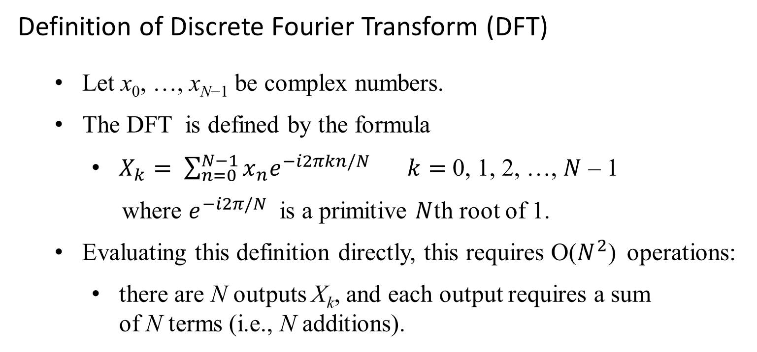
Polynomials and the Fast Fourier Transform (FFT)
Definition of Discrete Fourier Transform (DFT)
Let x₀, …, x_{N−1} be complex numbers.
The DFT is defined by the formula
$X_{k}= \sum_{n=0}^{N−1}{x_{n}e^{−i2πkn/N}} k=$ 0, 1, 2, …, $N$ – 1
where $e^{−i2π/N}$ is a primitive $N$th root of 1.
Evaluating this definition directly, this requires O($N^{2}$) operations:
there are N outputs X_{k}, and each output requires a sum of N terms (i.e., N additions).

Slide 4
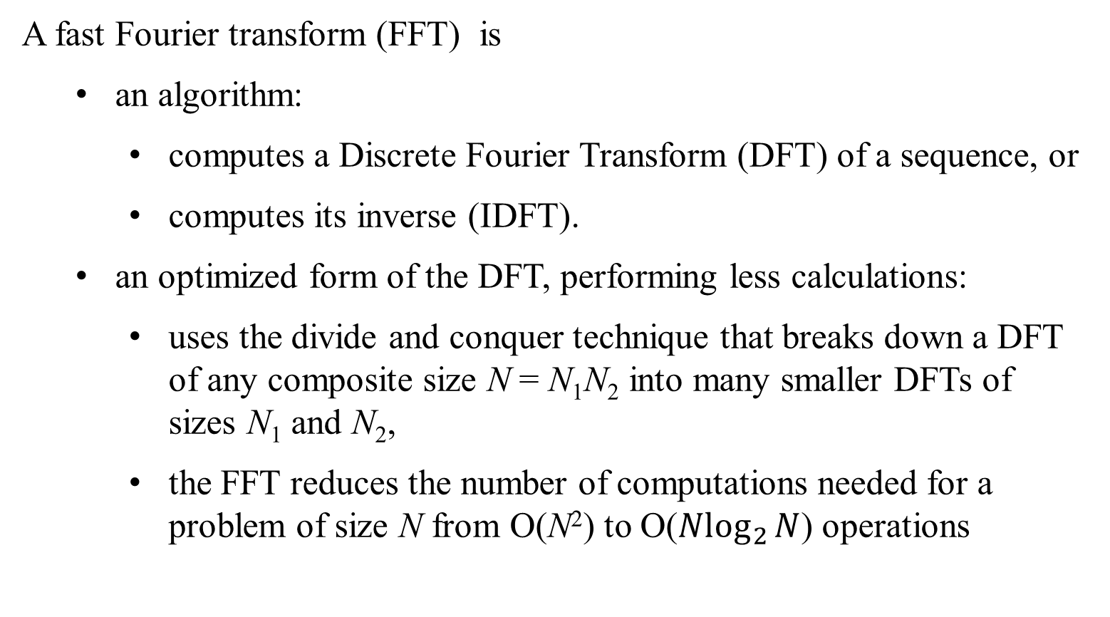
Polynomials and the Fast Fourier Transform (FFT)
A fast Fourier transform (FFT) is
an algorithm:
computes a Discrete Fourier Transform (DFT) of a sequence, or
computes its inverse (IDFT).
an optimized form of the DFT, performing less calculations:
uses the divide and conquer technique that breaks down a DFT of any composite size N = N₁N₂ into many smaller DFTs of sizes N₁ and N₂,
the FFT reduces the number of computations needed for a problem of size N from O(N²) to O(${Nlog}_{2}{N}$) operations

Slide 5
Polynomials and the Fast Fourier Transform (FFT)
Fast Fourier transform (FFT) algorithm:
Widely used for applications in engineering, music, science, and mathematics.
Used in digital recording, sampling, additive synthesis and pitch correction software.
Used extensively in audio processing, radar, sonar and software defined radio.
Compression techniques used to encode digital video and audio information, such as MP3 files (formally MPEG-1 Audio Layer III or MPEG-2 Audio Layer III), an audio coding format for digital audio.
Used in signal processing.

Slide 6
Polynomials
The straightforward method takes
Θ(n) time for adding two polynomials of degree n, and
Θ(n² ) time for multiplying them.
Show how the Fast Fourier transform (FFT) can reduce the time to Θ(n log n) for multiplying polynomials.

Slide 7
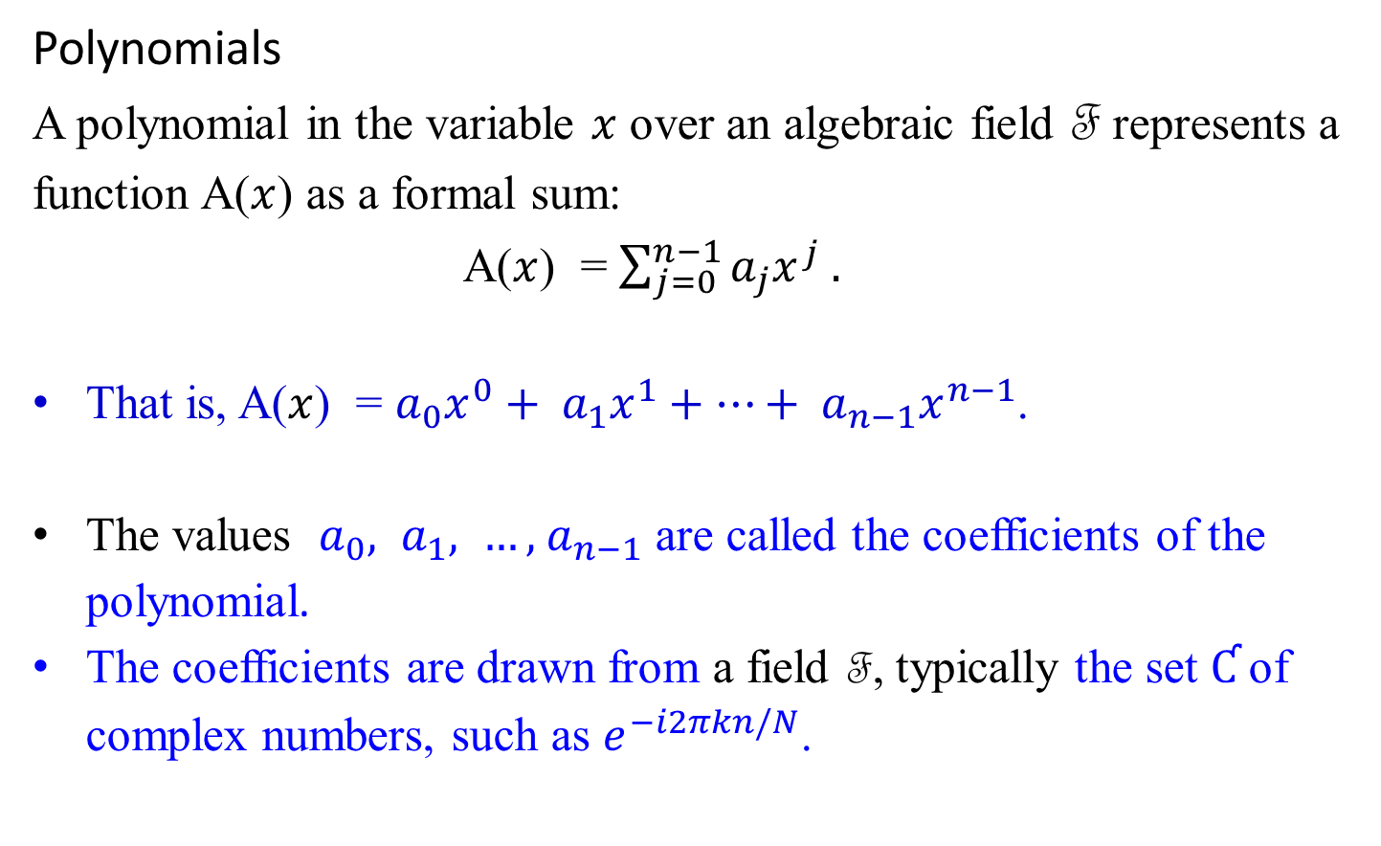
Polynomials
Polynomials
A polynomial in the variable $x$ over an algebraic field F represents a function A($x$) as a formal sum:
A($x$) = $\sum_{j=0}^{n−1}{a_{j}x^{j} .}$
That is, A($x$) = $a_{0}x^{0}+ a_{1}x^{1}+…+ a_{n−1}x^{n−1}$.
The values $a_{0}, a_{1}, …, { a}_{n−1}$ are called the coefficients of the polynomial.
The coefficients are drawn from a field F, typically the set Ƈ of complex numbers, such as $e^{−i2πkn/N}$.
r

Slide 8
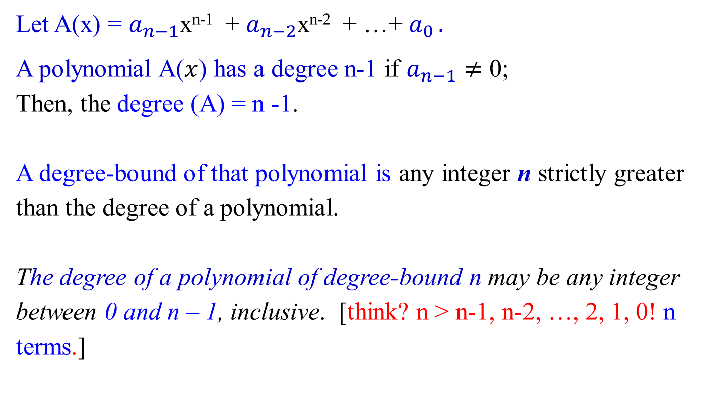
Polynomials
Let A(x) = $a_{n−1}$x^{n-1} + $a_{n−2}$x^{n-2} + …+ $a_{0 }.$
A polynomial A($x$) has a degree n-1 if $a_{n−1}≠$ 0;
Then, the degree (A) = n -1.
A degree-bound of that polynomial is any integer n strictly greater than the degree of a polynomial.
The degree of a polynomial of degree-bound n may be any integer between 0 and n – 1, inclusive. [think? n > n-1, n-2, …, 2, 1, 0! n terms.]

Slide 9
Operations on Polynomials
Polynomial addition:
Polynomial multiplication:

Slide 10
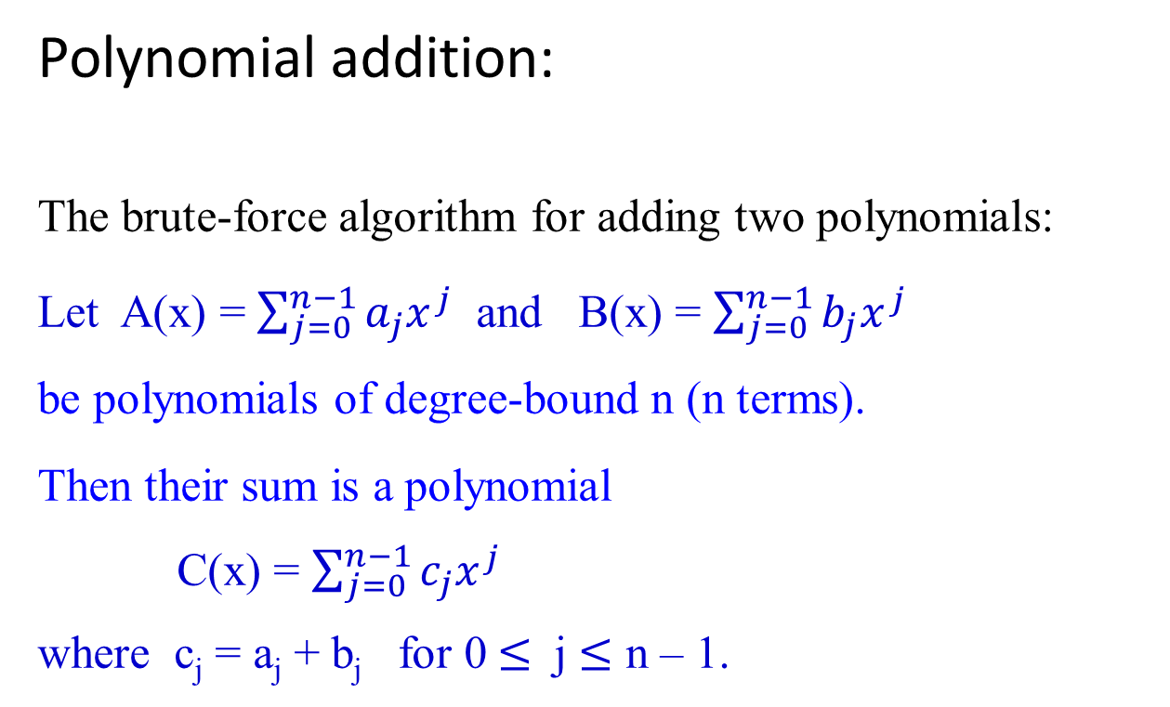
Polynomial addition:
The brute-force algorithm for adding two polynomials:
Let A(x) = $\sum_{j=0}^{n−1}{a_{j}x^{j}}$ and B(x) = $\sum_{j=0}^{n−1}{b_{j}x^{j}}$
be polynomials of degree-bound n (n terms).
Then their sum is a polynomial
C(x) = $\sum_{j=0}^{n−1}{c_{j}x^{j}}$
where c_{j} = a_{j} + b_{j} for 0 $≤$ j $≤$ n – 1.

Slide 11
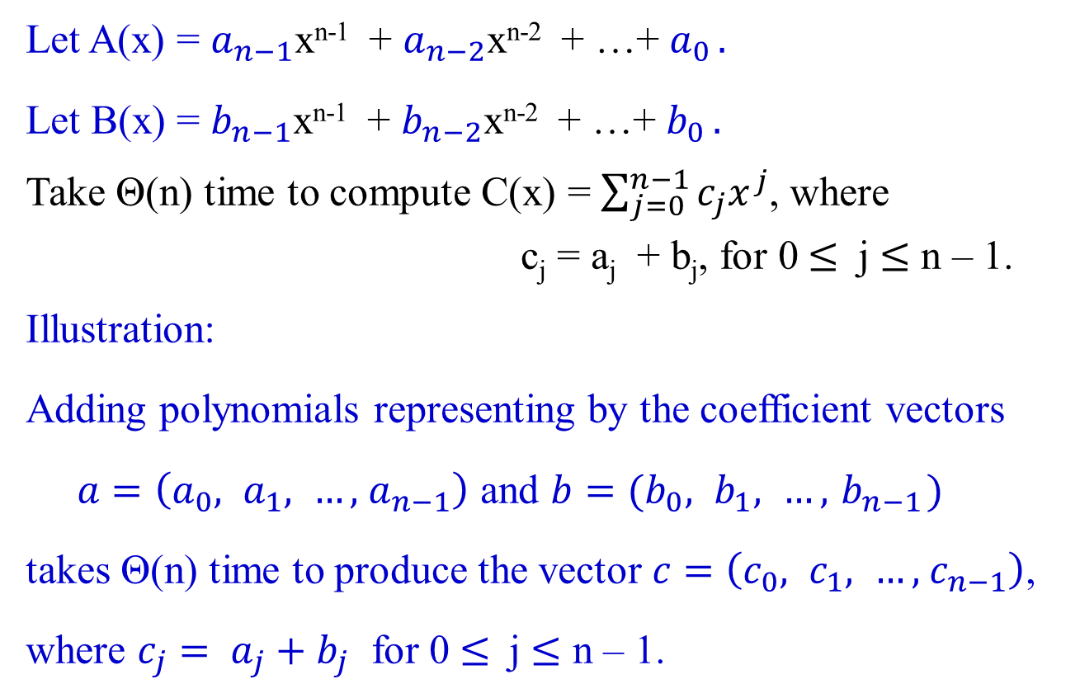
Polynomial addition:
Let A(x) = $a_{n−1}$x^{n-1} + $a_{n−2}$x^{n-2} + …+ $a_{0 }.$
Let B(x) = $b_{n−1}$x^{n-1} + $b_{n−2}$x^{n-2} + …+ $b_{0 }.$
Take Θ(n) time to compute C(x) = $\sum_{j=0}^{n−1}{c_{j}x^{j}}$, where
c_{j} = a_{j} + b_{j}, for 0 $≤$ j $≤$ n – 1.
Illustration:
Adding polynomials representing by the coefficient vectors
$a=\left(a_{0}, a_{1}, …, { a}_{n−1}\right)$ and $b=(b_{0}, b_{1}, …, { b}_{n−1})$
takes Θ(n) time to produce the vector $c=\left(c_{0}, c_{1}, …, { c}_{n−1}\right)$,
where $c_{j}= a_{j}+b_{j}$ for 0 $≤$ j $≤$ n – 1.

Slide 12
Polynomial addition:
Example 2.18:
A(x) = 6x³ + 7x² - 10x + 9 i.e., ( 9, -10, 7, 6)
B(x) = -2x³ + 4x - 5 + i.e., (-5, 4, 0, -2)
C(x) = 4x³ + 7x² - 6x + 4. i.e., (9+(-5), (-10)+4, 7+0, 6+(-2))
encoded using 2’ complement as strings of 0 and 1 with 1 in the sign bit

Slide 13

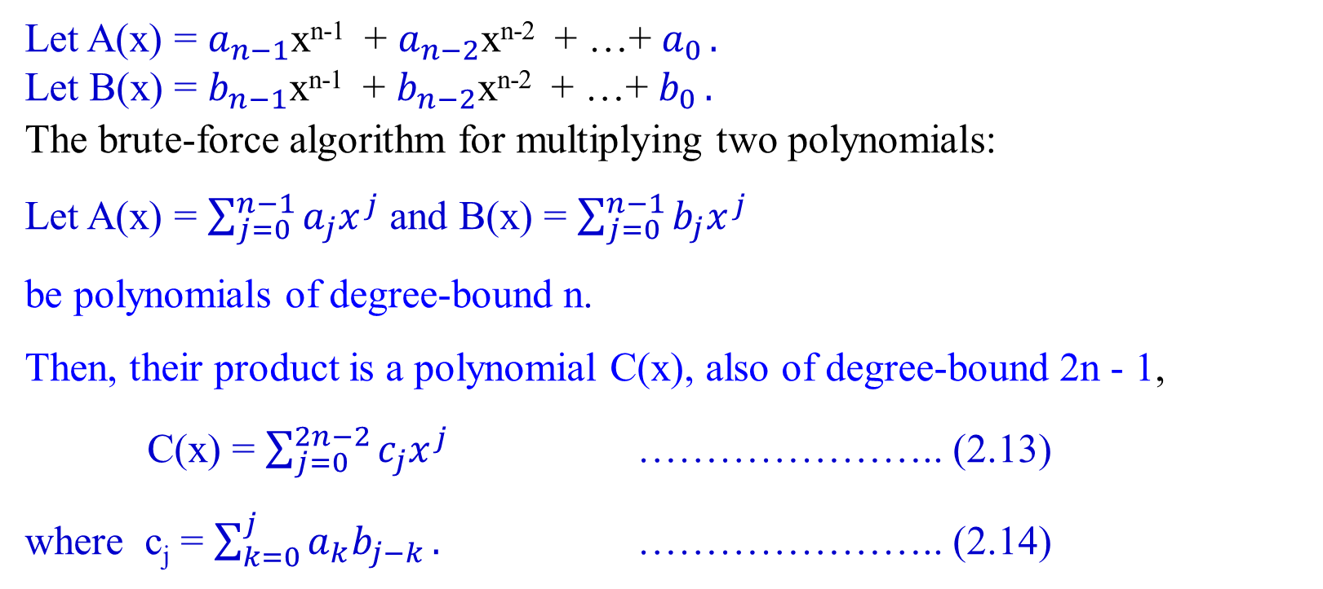
Polynomial multiplication:
Let A(x) = $a_{n−1}$x^{n-1} + $a_{n−2}$x^{n-2} + …+ $a_{0 }.$
Let B(x) = $b_{n−1}$x^{n-1} + $b_{n−2}$x^{n-2} + …+ $b_{0 }.$
The brute-force algorithm for multiplying two polynomials:
Let A(x) = $\sum_{j=0}^{n−1}{a_{j}x^{j}}$ and B(x) = $\sum_{j=0}^{n−1}{b_{j}x^{j}}$
be polynomials of degree-bound n.
Then, their product is a polynomial C(x), also of degree-bound 2n - 1,
C(x) = $\sum_{j=0}^{2n−2}{c_{j}x^{j}}$ ………………….. (2.13)
where c_{j} = $\sum_{k=0}^{j}{a_{k}b_{j−k}}.$ ………………….. (2.14)

Slide 14
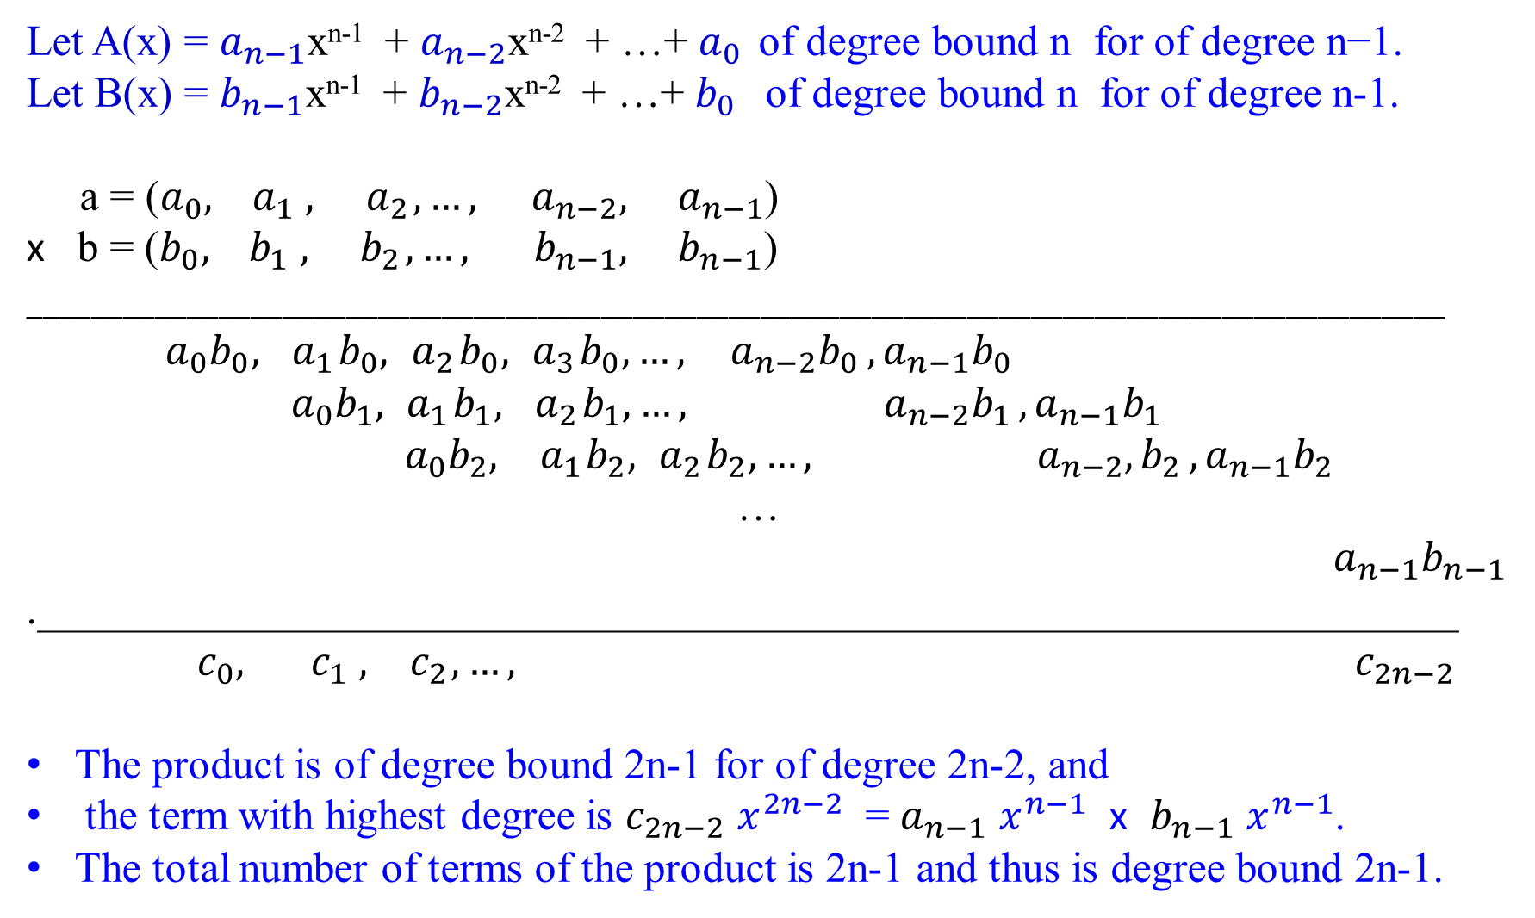
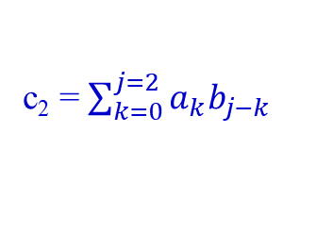
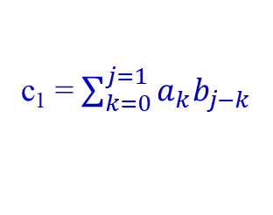
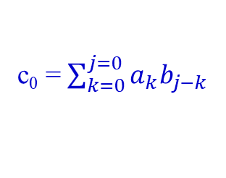
Let A(x) = $a_{n−1}$x^{n-1} + $a_{n−2}$x^{n-2} + …+ $a_{0 } \text{of} \text{degree} \text{bound} \text{n} \text{for} \text{of} \text{degree} \text{n}\text{−1}$.
Let B(x) = $b_{n−1}$x^{n-1} + $b_{n−2}$x^{n-2} + …+ $b_{0 }$ of degree bound n for of degree n-1.
a = ($a_{0}, { a}_{1},{ a}_{2},…, {{ a}_{n−2}, a}_{n−1}$)
x b = ($b_{0}, { b}_{1},{ b}_{2},…, {{ b}_{n−1}, b}_{n−1}$) $_________________________________________________________________________________________$
$a_{0}b_{0},{ a}_{1}b_{0},{ a}_{2}b_{0},{ a}_{3}b_{0},…, {{ a}_{n−2}b_{0 }, a}_{n−1}b_{0}$
$${ a}_{0}b_{1},{ a}_{1}b_{1},{ a}_{2}b_{1}, …, {{ a}_{n−2}b_{1 }, a}_{n−1}b_{1}$$
$${ a}_{0}b_{2},{ a}_{1}b_{2},{ a}_{2}b_{2}, …, {{ a}_{n−2},b_{2 }, a}_{n−1}b_{2}$$
…
${ a}_{n−1}b_{n−1}$
.__________________________________________________________________${ c}_{0}, { c}_{1},{ c}_{2},…, { c}_{2n−2}$
The product is of degree bound 2n-1 for of degree 2n-2, and
the term with highest degree is $c_{2n−2}$ $x^{2n−2}$ = $a_{n−1}$ $x^{n−1}$ x $b_{n−1}$ $x^{n−1}$.
The total number of terms of the product is 2n-1 and thus is degree bound 2n-1.
c₀ = $\sum_{k=0}^{j=0}{a_{k}b_{j−k} }$
c₁ = $\sum_{k=0}^{j=1}{a_{k}b_{j−k} }$
c₂ = $\sum_{k=0}^{j=2}{a_{k}b_{j−k} }$

Slide 15
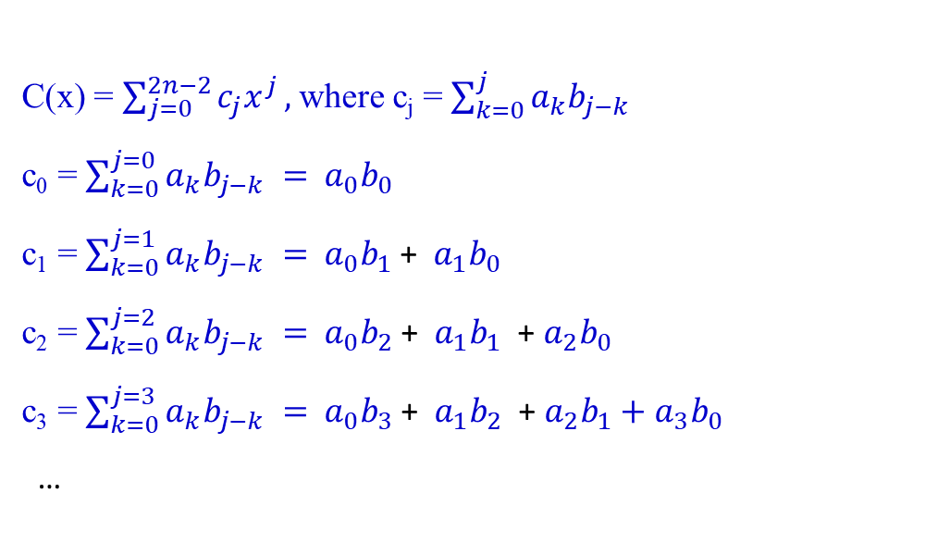
A and B are degree-bound n.
i.e., each of A and B has n=4 terms.
They are of degree n-1 which is 3.
Their product is of degree-bound 2n-1.
e.g.,The product of A*B has 7 terms.
It is of degree 2n-2 (i.e., 6).
C(x) = $\sum_{j=0}^{2n−2}{c_{j}x^{j}},$where c_{j} = $\sum_{k=0}^{j}{a_{k}b_{j−k} }$
c₀ = $\sum_{k=0}^{j=0}{a_{k}b_{j−k} }=$ $a_{0}b_{0}$
c₁ = $\sum_{k=0}^{j=1}{a_{k}b_{j−k} }=$ $a_{0}b_{1}$ + $a_{1}b_{0}$
c₂ = $\sum_{k=0}^{j=2}{a_{k}b_{j−k} }=$ $a_{0}b_{2}$ + $a_{1}b_{1}$ + $a_{2}b_{0}$
c₃ = $\sum_{k=0}^{j=3}{a_{k}b_{j−k} }=$ $a_{0}b_{3}$ + $a_{1}b_{2}$ + $a_{2}b_{1}+a_{3}b_{0}$
…
Example 2.19
6x³ + 7x² - 10x + 9
- 2x³ + 0x² + 4x - 5
- 30x³ - 35x² + 50x - 45
- 24x⁴ - 28x³ - 40x² - 36x
+ 0x⁵ + 0x⁴ + 0x³ + 0x²
- 12x⁶ - 14x⁵ + 20x⁴ - 18x³ .
- 12x⁶ - 14x⁵ + 44x⁴ - 20x³ - 75x² + 86x - 45

Slide 16

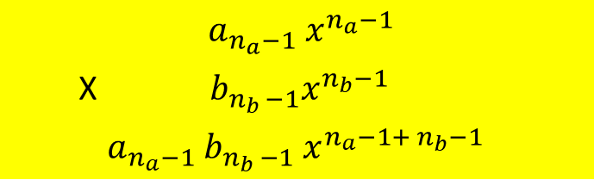

Polynomial multiplication:
$${ a_{n_{a}−1} x}^{n_{a}−1}$$
X $b_{n_{b }−1}x^{n_{b}−1}$
${ a}_{n_{a}−1}$ $b_{n_{b }−1}$ $x^{{n_{a}−1+ n}_{b}−1}$
${ a_{n_{a}−1} x}^{n_{a}−1}$ * $b_{n_{b −1}}x^{n_{b}−1}$
i.e., (n_{a} – 1) + (n_{b} – 1) = n_{a} + n_{b} – 2
For C = A * B, degree(C) = degree(A) + degree(B).
Let A be a polynomial of degree n_{a} - 1 (also of degree-bound n_{a})and
B be a polynomial of degree n_{b} – 1 (also of degree-bound n_{b}).
Then, C is a polynomial of degree n_{a} + n_{b} – 2.
That is, C is a polynomial of degree-bound n_{a} + n_{b} – 1 (i.e., terms???).
Since a polynomial of degree-bound k is also a polynomial of degree-bound k + 1, then the product polynomial C is a polynomial of degree-bound n_{a} + n_{b}.

Slide 17
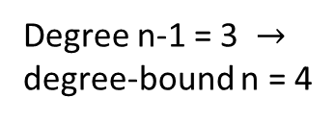
Degree n-1 = 3 $→$ degree-bound n = 4
Example 2.20
a₃ x³ + a₂ x² + a₁ x¹ + a₀ x⁰
* b₃ x³ + b₂ x² + b₁ x¹ + b₀ x⁰
a₃b₀ x³ + a₂b₀ x² + a₁b₀ x¹ + a₀b₀ x⁰
a₃b₁ x⁴ + a₂b₁ x³ + a₁b₁ x² + a₀b₁ x¹
a₃b₂ x⁵ + a₂b₂ x⁴ + a₁b₂ x³ + a₀b₂ x²
a₃b₃ x⁶ + a₂b₃ x⁵ + a₁b₃ x⁴ + a₀b₃ x³
a₃b₃ x⁶ + (a₃b₂ + a₂b₃) x⁵ + (a₃b₁ + a₂b₂ + a₁b₃ ) x⁴ + (a₃b₀ + a₂b₁ + a₁b₂+ a₀b₃ ) x³ + (a₂b₀+ a₁b₁+ a₀b₂) x² + (a₁b₀ + a₀b₁) x¹ + a₀b₀ x⁰
Degree bound is 7
n = 4
16 = 4² multiplications (in general multiplying two polynomials, each of degree-bounded n, requires n² ) plus 15 additions

Slide 18
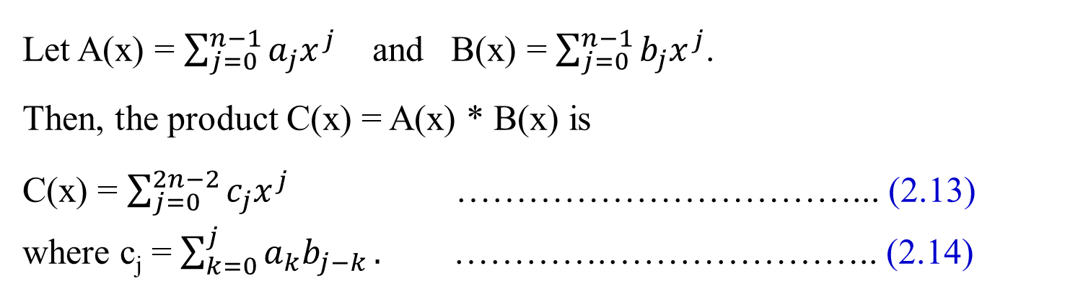
Polynomial multiplication:
Let A(x) = $\sum_{j=0}^{n−1}{a_{j}x^{j}}$ and B(x) = $\sum_{j=0}^{n−1}{b_{j}x^{j}}$.
Then, the product C(x) = A(x) * B(x) is
C(x) = $\sum_{j=0}^{2n−2}{c_{j}x^{j}}$ ……………………………... (2.13)
where c_{j} = $\sum_{k=0}^{j}{a_{k}b_{j−k}}.$ ………….………………….. (2.14)

Slide 19
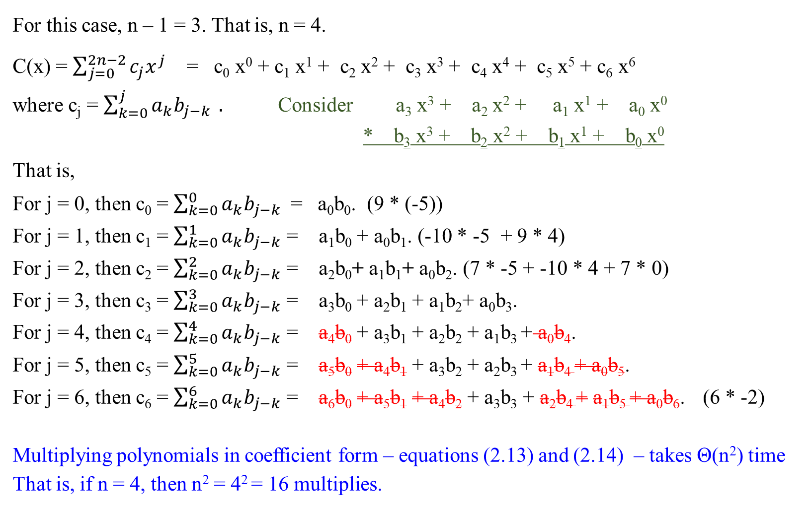
Polynomial multiplication:
For this case, n – 1 = 3. That is, n = 4.
C(x) = $\sum_{j=0}^{2n−2}{c_{j}x^{j}}$ = c₀ x⁰ + c₁ x¹ + c₂ x² + c₃ x³ + c₄ x⁴ + c₅ x⁵ + c₆ x⁶
where c_{j} = $\sum_{k=0}^{j}{a_{k}b_{j−k}} .$ Consider a₃ x³ + a₂ x² + a₁ x¹ + a₀ x⁰
* b₃ x³ + b₂ x² + b₁ x¹ + b₀ x⁰
That is,
For j = 0, then c₀ = $\sum_{k=0}^{0}{a_{k}b_{j−k}}$ = a₀b₀. (9 * (-5))
For j = 1, then c₁ = $\sum_{k=0}^{1}{a_{k}b_{j−k}}$ = a₁b₀ + a₀b₁. (-10 * -5 + 9 * 4)
For j = 2, then c₂ = $\sum_{k=0}^{2}{a_{k}b_{j−k}}$ = a₂b₀+ a₁b₁+ a₀b₂. (7 * -5 + -10 * 4 + 7 * 0)
For j = 3, then c₃ = $\sum_{k=0}^{3}{a_{k}b_{j−k}}$ = a₃b₀ + a₂b₁ + a₁b₂+ a₀b₃.
For j = 4, then c₄ = $\sum_{k=0}^{4}{a_{k}b_{j−k}}$ = a₄b₀ + a₃b₁ + a₂b₂ + a₁b₃ + a₀b₄.
For j = 5, then c₅ = $\sum_{k=0}^{5}{a_{k}b_{j−k}}$ = a₅b₀ + a₄b₁ + a₃b₂ + a₂b₃ + a₁b₄ + a₀b₅.
For j = 6, then c₆ = $\sum_{k=0}^{6}{a_{k}b_{j−k}}$ = a₆b₀ + a₅b₁ + a₄b₂ + a₃b₃ + a₂b₄ + a₁b₅ + a₀b₆. (6 * -2)
Multiplying polynomials in coefficient form – equations (2.13) and (2.14) – takes Θ(n²) time That is, if n = 4, then n² = 4² = 16 multiplies.

Slide 20
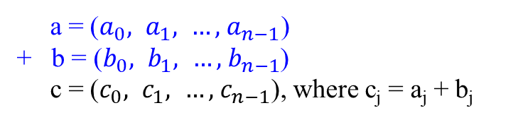
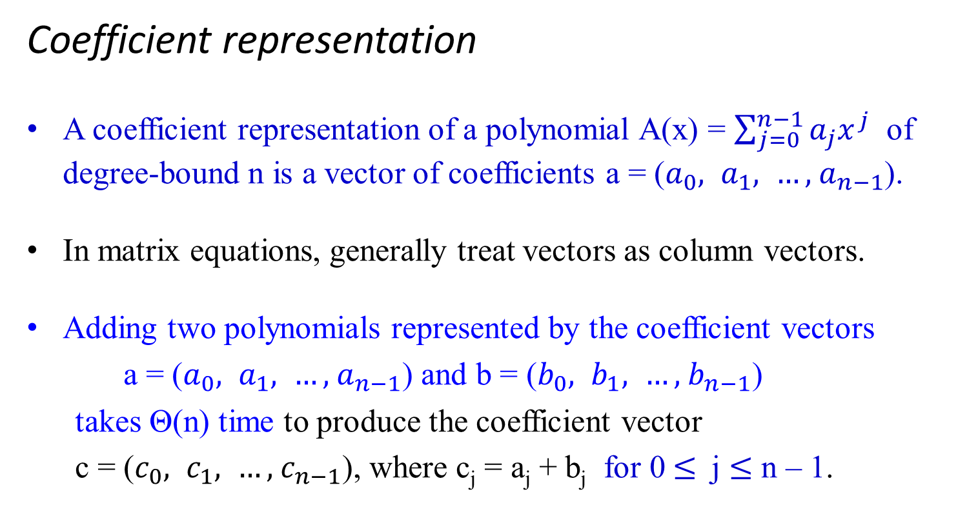
a = ($a_{0}, a_{1}, …, { a}_{n−1}$)
+ b = ($b_{0}, b_{1}, …, { b}_{n−1}$)
c = ($c_{0}, c_{1}, …, { c}_{n−1}$), where c_{j} = a_{j} + b_{j}
Coefficient representation
A coefficient representation of a polynomial A(x) = $\sum_{j=0}^{n−1}{a_{j}x^{j}}$ of degree-bound n is a vector of coefficients a = ($a_{0}, a_{1}, …, { a}_{n−1}$).
In matrix equations, generally treat vectors as column vectors.
Adding two polynomials represented by the coefficient vectors
a = ($a_{0}, a_{1}, …, { a}_{n−1}$) and b = ($b_{0}, b_{1}, …, { b}_{n−1}$)
takes Θ(n) time to produce the coefficient vector
c = ($c_{0}, c_{1}, …, { c}_{n−1}$), where c_{j} = a_{j} + b_{j} for 0 $≤$ j $≤$ n – 1.

Slide 21

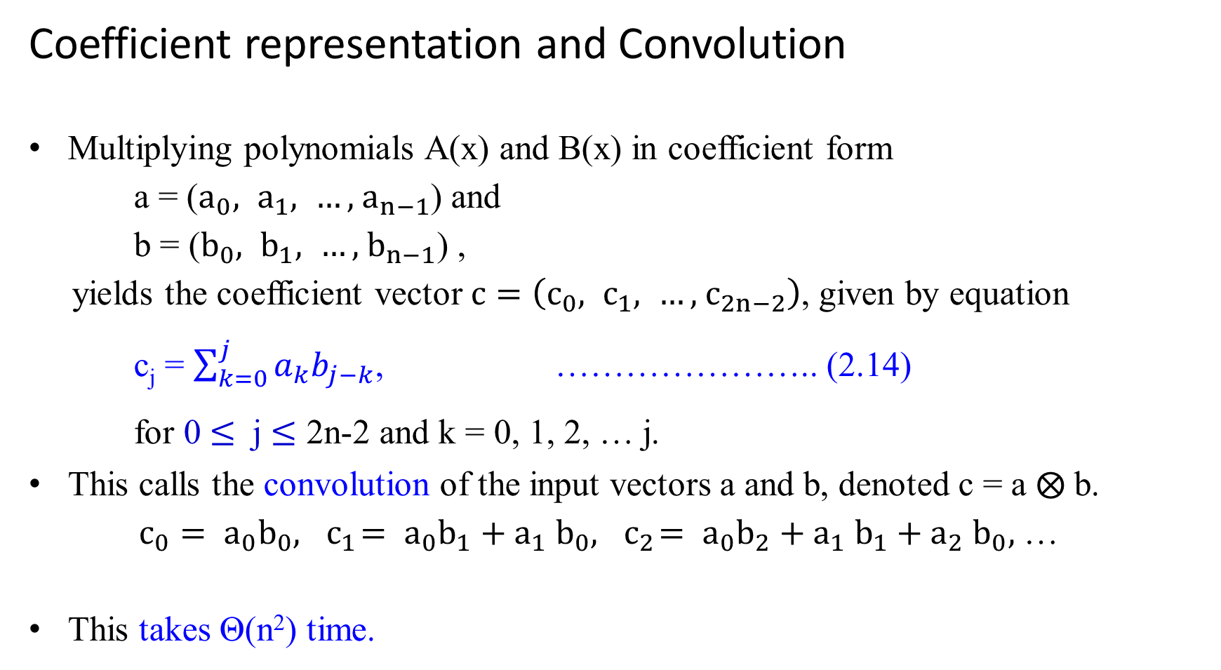
Coefficient representation and Convolution
Multiplying polynomials A(x) and B(x) in coefficient form
a = ($a_{0}, a_{1}, …, { a}_{n−1}$) and
b = ($b_{0}, b_{1}, …, { b}_{n−1}$) ,
yields the coefficient vector $c=\left(c_{0}, c_{1}, …, { c}_{2n−2}\right)$, given by equation
c_{j} = $\sum_{k=0}^{j}{a_{k}b_{j−k}}$, ………………….. (2.14)
for 0 $≤$ j $≤$ 2n-2 and k = 0, 1, 2, … j.
This calls the convolution of the input vectors a and b, denoted c = a $⨂$ b.
$c_{0}= a_{0}b_{0}, { c}_{1}= a_{0}b_{1}{+ a}_{1}b_{0}, { c}_{2}= a_{0}b_{2}{+ a}_{1}b_{1}{+ a}_{2}b_{0},$ …
This takes Θ(n²) time.

Slide 22
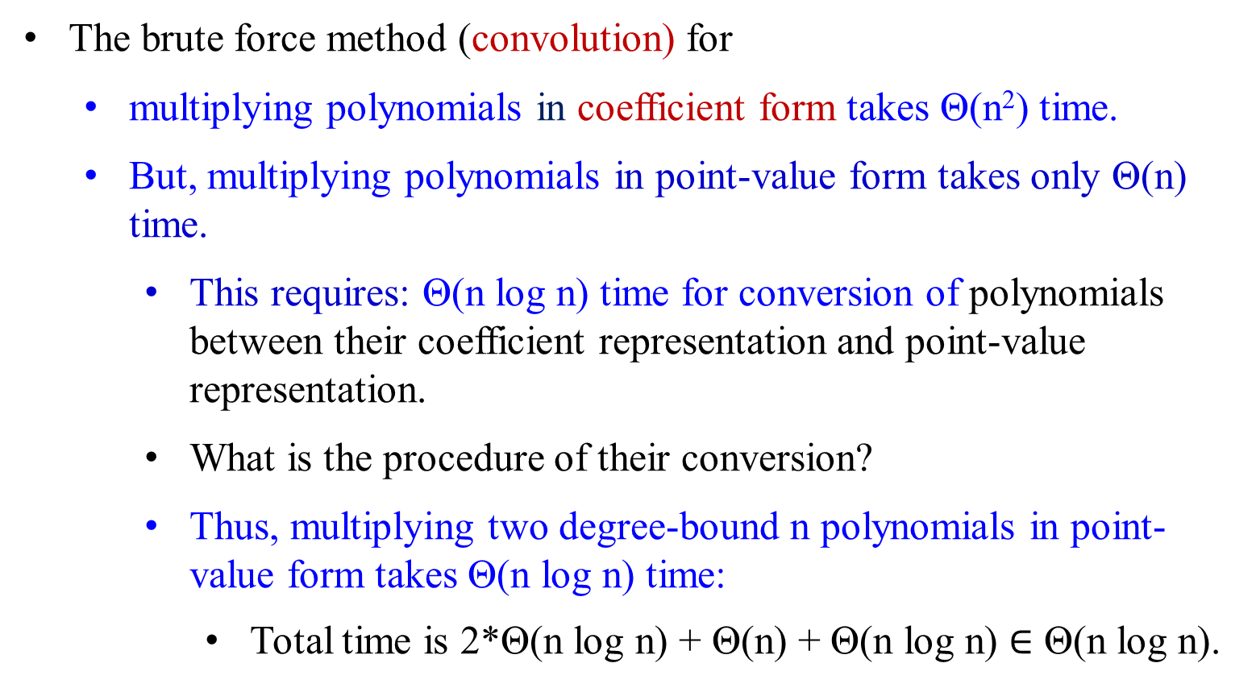
Polynomial multiplication:
The brute force method (convolution) for
multiplying polynomials in coefficient form takes Θ(n²) time.
But, multiplying polynomials in point-value form takes only Θ(n) time.
This requires: Θ(n log n) time for conversion of polynomials between their coefficient representation and point-value representation.
What is the procedure of their conversion?
Thus, multiplying two degree-bound n polynomials in point-value form takes Θ(n log n) time:
Total time is 2*Θ(n log n) + Θ(n) + Θ(n log n) $∈$ Θ(n log n).

Slide 23
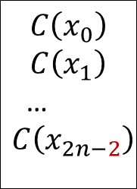
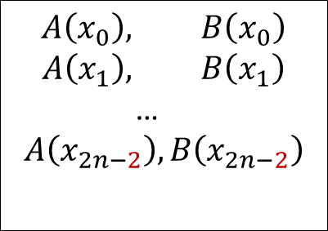
Comment: for x³, If n-1=3, then n=4 terms for x⁶, if 2n-2=6, then 2n-1=7 terms
a₀ , a₁, …, a_{n-1}
b₀ , b₁, …, b_{n-1}
Ordinary
Multiplication
Time Θ(n²)
c₀ , c₁, …, c_{2n-2}
Coefficient
representation
convolution
Evaluation Interpolation
Time Θ(n²), Time Θ(n²)
using Horner Rule using Lagrange’s formula
$$A\left(x_{0}\right), B\left(x_{0}\right)$$
$$A\left(x_{1}\right), B\left(x_{1}\right)$$
…
$$A\left(x_{2n−2}\right), B\left(x_{2n−2}\right)$$
Pointwise multiplication
$$C\left(x_{0}\right)$$
$$C\left(x_{1}\right)$$
…
$$C\left(x_{2n−2}\right)$$
Point-value
multiplication
Time Θ(n)
Polynomial multiplication:

Slide 24

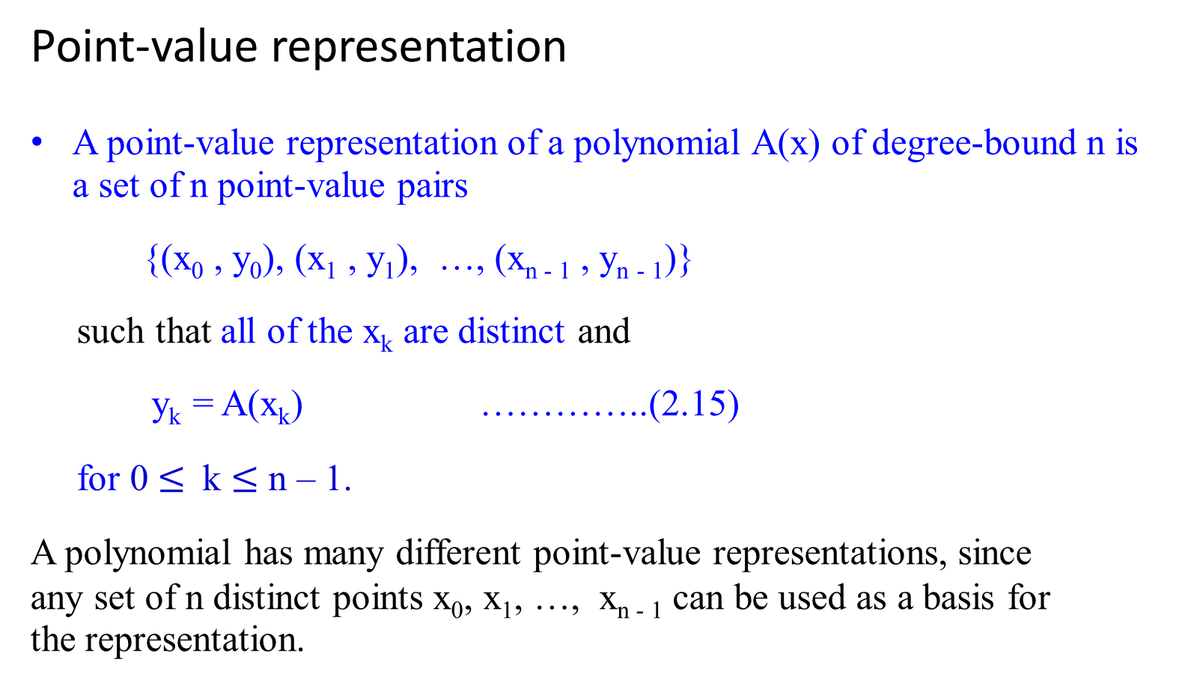
Point-value representation
A point-value representation of a polynomial A(x) of degree-bound n is a set of n point-value pairs
{(x₀ , y₀), (x₁ , y₁), …, (x_{n - 1} , y_{n - 1})}
such that all of the x_{k} are distinct and
y_{k} = A(x_{k}) …………..(2.15)
for 0 $≤$ k $≤$ n – 1.
A polynomial has many different point-value representations, since any set of n distinct points x₀, x₁, …, x_{n - 1} can be used as a basis for the representation.
y = A(x) = a₃ x³ + a₂ x² + a₁ x¹ + a₀ x⁰
y_{k} = A(x_{k}) = a₃ x_{k}³ + a₂ x_{k}² + a₁ x_{k}¹ + a₀ x_{k}⁰

Slide 25
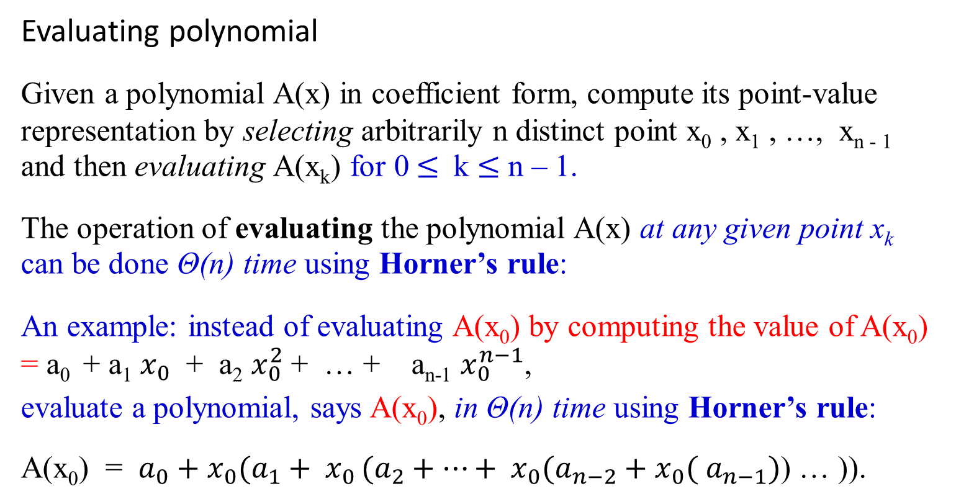
Converting between Coefficient form and Point-value Representation
Evaluating polynomial
Given a polynomial A(x) in coefficient form, compute its point-value representation by selecting arbitrarily n distinct point x₀ , x₁ , …, x_{n - 1} and then evaluating A(x_{k}) for 0 $≤$ k $≤$ n – 1.
The operation of evaluating the polynomial A(x) at any given point x_{k} can be done Θ(n) time using Horner’s rule:
An example: instead of evaluating A(x₀) by computing the value of A(x₀) = a₀ + a₁ $x_{0}$ + a₂ $x_{0}^{2}$ + … + a_{n-1} $x_{0}^{n−1}$,
evaluate a polynomial, says A(x₀), in Θ(n) time using Horner’s rule:
A(x₀) = $a_{0}+x_{0}(a_{1}+ x_{0 }(a_{2}+…+ x_{0}(a_{n−2}+x_{0}( a_{n−1})$) … )).
y_{k} = a₃ x_{k}³ + a₂ x_{k}² + a₁ x_{k}¹ + a₀ x_{k}⁰ yields y_{k} = (((a₃) x_{k} + a₂ ) x_{k} + a₁) x_{k} + a₀

Slide 26
Converting between Coefficient form and Point-value Representation
Evaluating polynomial A(x)
Using the Horner’s rule, compute the value of A(x) at a point x₀, i.e., A(x₀) in Θ(n) time.
Then, evaluate a polynomial at n points, A(x₀), A(x₁), A(x₂), …, A(x_{n-1}) take time Θ(n²) of multiplications.
From this set of slides, let learn how to
convert (evaluate) coefficient form to point-value form
convert (interpolate) point-value form to coefficient form, using Lagrange’s formula) .
We shall see later that if we choose the points x_{k} cleverly, this computation can be accelerated to run in time Θ(n log n).

Slide 27
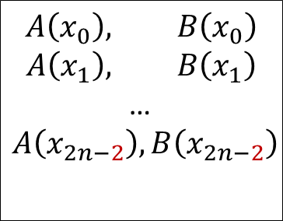
Comment: for x³, If n-1=3, then n=4 terms for x⁶, if 2n-1=6, then 2n=7 terms
a₀ , a₁, …, a_{n-1}
b₀ , b₁, …, b_{n-1}
Ordinary
Multiplication
Time Θ(n²)
convolution
c₀ , c₁, …, c_{2n-2}
Coefficient
representation
Evaluation Interpolation
Time Θ(n²), Time Θ(n²)
using Horner Rule using Lagrange’s formula
$$A\left(x_{0}\right), B\left(x_{0}\right)$$
$$A\left(x_{1}\right), B\left(x_{1}\right)$$
…
$$A\left(x_{2n−2}\right), B\left(x_{2n−2}\right)$$
$$C\left(x_{0}\right)$$
$$C\left(x_{1}\right)$$
…
$$C\left(x_{2n−2}\right)$$
Pointwise multiplication
Point-value
multiplication
Time Θ(n)
To compute A*B

Slide 28
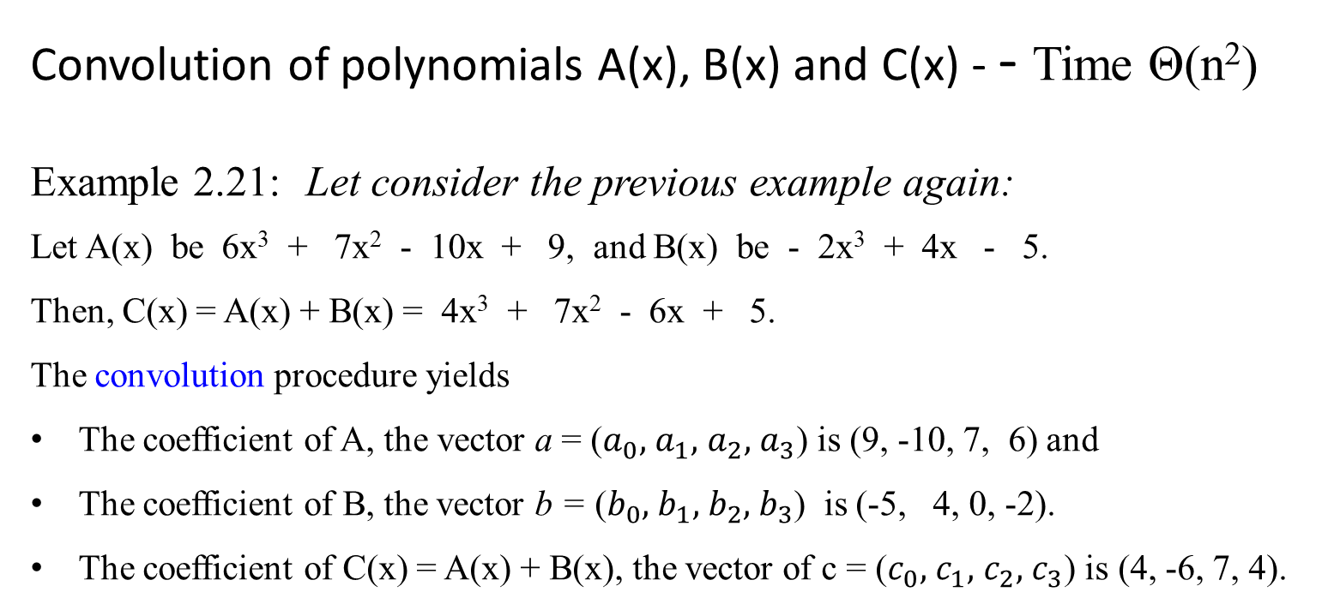
Converting between Coefficient form and Point-value Representation
Convolution of polynomials A(x), B(x) and C(x) - - Time Θ(n²)
Example 2.21: Let consider the previous example again:
Let A(x) be 6x³ + 7x² - 10x + 9, and B(x) be - 2x³ + 4x - 5.
Then, C(x) = A(x) + B(x) = 4x³ + 7x² - 6x + 5.
The convolution procedure yields
The coefficient of A, the vector a = ($a_{0},$ $a_{1},$ $a_{2},$ $a_{3}$) is (9, -10, 7, 6) and
The coefficient of B, the vector b = ($b_{0},$ $b_{1},$ $b_{2},$ $b_{3}$) is (-5, 4, 0, -2).
The coefficient of C(x) = A(x) + B(x), the vector of c = ($c_{0},$ $c_{1},$ $c_{2},$ $c_{3}$) is (4, -6, 7, 4).
Convo lut
ion

Slide 29

Evaluating polynomials A(x), B(x) and C(x)
Let A(x) be 6x³ + 7x² - 10x + 9, and B(x) be - 2x³ + 4x - 5.
Then, C(x) = A(x) + B(x) = 4x³ + 7x² - 6x + 5.
Using Horner’s rule, their point-value representations can be computed by:
A(x₀) = $9 + x_{0}(−10+ x_{0 }(7 + x_{0}(6$))), and
B(x₀) = $−5 + x_{0}(4+ x_{0 }(0 + x_{0}(−2$))).
Since the polynomial A(x) of degree-bound 4, a set of 4 point-value pairs is needed for the summation of A(x) and B(x):
Pick arbitrarily x₀ = {0, 1, 2, 3}. Then
A(0) = 9, A(1) = 12, A(2) = 65, A(3) = 204, and
B(0) = -5, B(1) = -3, B(2) = -13, B(3) = -47.
Evaluation
x | A(x) | B(x) | C(x) = A(x) + B(x)
0 | 9 | -5 | 4
1 | 12 | -3 | 9
2 | 65 | -13 | 52
3 | 204 | -47 | 157
Point-value representations of A(x) is {(0, 9), (1, 12), (2, 65), (3, 204)},
of B(X) of degree-bound 4 is {(0, -5), (1, -3), (2, -13), (3, -47)}, and
of C(x) is {(0, 4), (1, 9), (2, 52), (3, 157)}
Point-value representations

Slide 30


a₀ , a₁, …, a_{n-1}
b₀ , b₁, …, b_{n-1}
Ordinary
Multiplication
Time Θ(n²)
c₀ , c₁, …, c_{2n-2}
(4, -6, 7, 4)
Coefficient
representation
(9, -10, 7, 6)
(-5, 4, 0, -2).
convolution
addition
Evaluation Interpolation
Time Θ(n²), Time Θ(n²)
using Horner Rule using Lagrange’s formula
$$A\left(x_{0}\right), B\left(x_{0}\right)$$
$$A\left(x_{1}\right), B\left(x_{1}\right)$$
…
$$A\left(x_{2n−2}\right), B\left(x_{2n−2}\right)$$
$$C\left(x_{0}\right)$$
$$C\left(x_{1}\right)$$
…
$$C\left(x_{2n−2}\right)$$
Pointwise multiplication
Point-value
multiplication
Time Θ(n)
(0, 9), (0, -5)
(1, 12), (1, -3)
(2, 65), (2, -13)
(3, 207), (3, -47)
(0, 4)
(1, 9)
(2, 52)
(3, 157)
To compute A*B

Slide 31

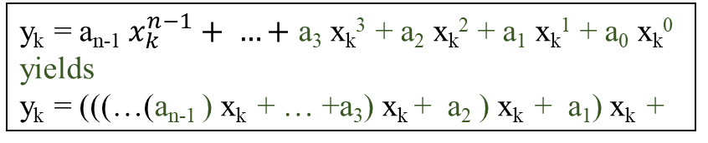
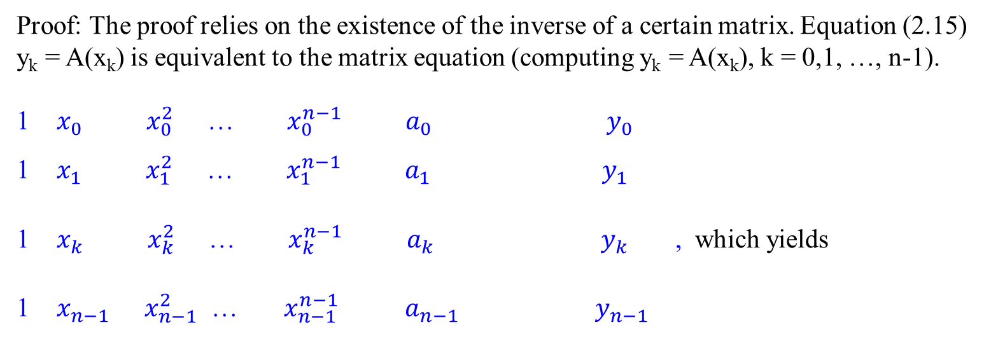

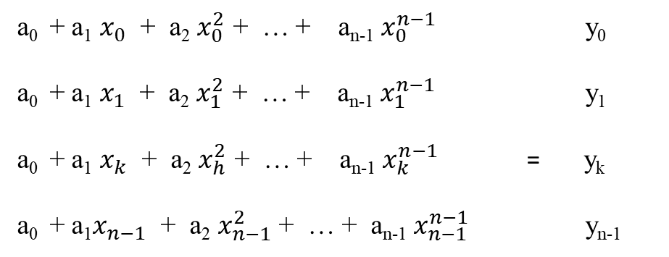
Evaluation: Another way to compute point-value representation of a polynomial
$${ x}_{k}^{0}=1{ x}_{k}^{1}=x_{k}$$
Proof: The proof relies on the existence of the inverse of a certain matrix. Equation (2.15) y_{k} = A(x_{k}) is equivalent to the matrix equation (computing y_{k} = A(x_{k}), k = 0,1, …, n-1).
1 $x_{0} { x}_{0}^{2}$ … $x_{0}^{n−1} a_{0}$ $y_{0}$
1 $x_{1} { x}_{1}^{2}$ … $x_{1}^{n−1}{ a}_{1}$ ${ y}_{1}$
1 $x_{k} { x}_{k}^{2}$ … $x_{k}^{n−1}$ ${ a}_{k}$ ${ y}_{k}$ , which yields
1 $x_{n−1} x_{n−1}^{2}$ … $x_{n−1}^{n−1}$ $a_{n−1}$ $y_{n−1}$
This takes Θ(n³).
=
a₀ + a₁ $x_{0}$ + a₂ $x_{0}^{2}$ + … + a_{n-1} $x_{0}^{n−1}$ y₀
a₀ + a₁ $x_{1}$ + a₂ $x_{1}^{2}$ + … + a_{n-1} $x_{1}^{n−1}$ y₁
a₀ + a₁ $x_{k}$ + a₂ $x_{h}^{2}$ + … + a_{n-1} $x_{k}^{n−1}$ = y_{k}
a₀ + a₁$x_{n−1}$ + a₂ $x_{n−1}^{2}$ + … + a_{n-1} $x_{n−1}^{n−1}$ y_{n-1}
(2.16)
y_{k} = a_{n-1} $x_{k}^{n−1}+ …+$ a₃ x_{k}³ + a₂ x_{k}² + a₁ x_{k}¹ + a₀ x_{k}⁰ yields
y_{k} = (((…(a_{n-1} ) x_{k} + … +a₃) x_{k} + a₂ ) x_{k} + a₁) x_{k} +

Slide 32
Example 2.22: Converting representation from point-value pairs form to coefficient form:
Consider A(x) = 6x³ + 7x² - 10x + 9 of degree-bound 4.
The coefficient form for the polynomial A(x) is (9, -10, 7, 6).
Using Horner’s rule, A(x) = 9 + x(-10 + x(7 + x(6))).
Then, compute (evaluate) A(x)’s value-point form.
Let x = {0, 1, 2, 3}.
A(0) = 9.
A(1) = 9 + 1(-10 + 1(7 + 1(6))) = 12 .
A(2) = 9 + 2(-10 + 2(7 + 2(6))) = 65.
A(3) = 9 + 3(-10 + 3(7 + 3(6))) = 204
Its value-point form (0, 9), (1, 12), (2, 65), (3, 204) is obtained.
This above evaluating A(x_{k}), k = 0, 1, 2, 3 can be done:

Slide 33
This above evaluating A(x_{k}), k = 0, 1, 2, 3 can be done:
1 0 0 0 9 9
1 1 1 1 -10 12
1 2 4 8 7 65
1 3 9 27 6 204
=
Evaluation : Another way to compute point-value representations from coefficient vector for polynomial A(x)
For A(x) = 6x³ + 7x² - 10x + 9 of degree-bound 4, the coefficient form for the polynomial A(x) is (9, -10, 7, 6). Let {x₀, x₀, x₀, x₀} = {0, 1, 2, 3}. its value-point form representation (0, 9), (1, 12), (2, 65), (3, 204) can be obtained.

Slide 34

Interpolating polynomial –
the inverse of evaluation (interpolation)
Interpolation - the inverse of evaluation:
determining the coefficient form of a polynomial from a point-value representation.
Theorem 2.4 (Uniqueness of an interpolating polynomial)
For any set {(x₀ , y₀), (x₁ , y₁), …, (x_{n - 1} , y_{n - 1})} of n point-value pairs such that all the x_{k} values are distinct, there is a unique polynomial A(x) of degree-bound n such that y_{k} = A(x_{k}) for k = 0, 1, 2, …, n – 1.
This Theorem shows that interpolation is well-defined when the desired interpolating polynomial must have a degree-bound equal to the given number of point-value pairs.

Slide 35

Given the point-value representation, interpolating A(x) can be done:
0 0 0 0⁰ 0¹ 0² 0³
1 1 1 1 1⁰ 1¹ 1² 1³
1 2 4 8 2⁰ 2¹ 2² 2³
1 3 9 27 3⁰ 3¹ 3² 3³
Since det(V(x₀ , x₁ , …, x_{n - 1}) )
=$\prod_{0 ≤j<k≤n−1}{(x_{k}}− x_{j} )$
= (x₁ – x₀) (x₂ – x₀) (x₃ – x₀) (x₂ – x₁) (x₃ – x₁) (x₃ – x₂)
= (1 - 0)(2 - 0)(3 - 0)(2 - 1)(3 - 1)(3 - 2) = 1*2*3*1*2*1=12
≠ 0, it is nonsingular,
a = V(x₀ , x₁ , …, x_{n - 1})⁻¹ * y. ……2.16
V(0, 1, 2, 3) =
As j goes from 0 to 2, k is from 1 to 3.

Slide 36
That is,
a₀ 1 0 0 0 ⁻¹ 9 9
a₁ 1 1 1 1 12 -10
a₂ 1 2 4 8 65 7
a₃ 1 3 9 27 204 6
=
=
Interpolation: Another way to compute coefficient vector from point-value representations for polynomial A(x). This takes Θ(n³).

Slide 37
The proof of Theorem 2.4 describes an algorithm for interpolation based on solving the set y = V(x₀ , x₁ , …, x_{n - 1}) * a
(2.16) of linear equations. Using the LU decomposition algorithms, we can solve these equations in time Θ(n³).

Slide 38

Fast n-point interpolation algorithm – from point-value form back to coefficients
A fast algorithm for n-point interpolation is based on Lagrange’s formula:
A(x) = $\sum_{k=0}^{n−1}{y_{k}} \frac{\prod_{j≠k}{(x− x_{j})}}{\prod_{j≠k}{(x_{k}}− x_{j})}$ …………… (2.17)
The right-hand side of equation (2.17) is a polynomial of degree-bound n that satisfies A(x_{k}) = y_{k} for all k.
Compute the coefficients of A using Lagrange’s formula in time Θ(n²).
Thus, n-point evaluation and interpolation are well-defined inverse operations that transform between the coefficient representation of a polynomial and a point-value representation.
S

Slide 39


Fast n-point interpolation algorithm – from point-value form back to coefficients
Example 2.23: Example of A(x) interpolation using Lagrange formula:
Consider the polynomial A(x) = 6x³ + 7x² - 10x + 9 of degree-bound 4.
Its value-point form (0, 9), (1, 12), (2, 65), (3, 204) is obtained in example 2.22.
Then, interpolate this point-value representation of a polynomial A(x)
(0, 9), (1, 12), (2, 65), (3, 204)
to form the coefficient (9, -10, 7, 6) of the polynomial A(x) using Lagrange’s formula - (2.17):
A(x) = $\sum_{k=0}^{n−1}{y_{k}} \frac{\prod_{j≠k}{(x− x_{j})}}{\prod_{j≠k}{(x_{k}}− x_{j})}$ ………… (2.17)

Slide 40

Fast n-point interpolation algorithm – from point-value form (0, 9), (1, 12), (2, 65), (3, 204) back to coefficients
A(x) = $\sum_{k=0}^{n−1}{y_{k}} \frac{\prod_{j≠k}{(x− x_{j})}}{\prod_{j≠k}{(x_{k}}− x_{j})}$
= y₀ (x – x₁) (x – x₂) (x – x₃) + y₁ (x – x₀) (x – x₂) (x – x₃)
(x₀ – x₁) (x₀ – x₂) (x₀ – x₃) (x₁ – x₀) (x₁ – x₂) (x₁ – x₃)
+ y₂ (x – x₀) (x – x₁) (x – x₃) + y₃ (x – x₀) (x – x₁) (x – x₂)
(x₂ – x₀) (x₂ – x₁) (x₂ – x₃) (x₃ – x₀) (x₃ – x₁) (x₃ – x₂)
= y₀ (x – 1) (x – 2) (x – 3) + y₁ (x – 0) (x – 2) (x – 3)
(0 – 1) (0 – 2) (0 – 3) (1 – 0) (1 – 2) (1 – 3)
+ y₂ (x – 0) (x – 1) (x – 3) + y₃ (x – 0) (x – 1) (x – 2)
(2 – 0) (2 – 1) (2 – 3) (3 – 0) (3 – 1) (3 – 2)

Slide 41

Fast n-point interpolation algorithm – from point-value form (0, 9), (1, 12), (2, 65), (3, 204) back to coefficients
= 9 (x – 1) (x – 2) (x – 3) + 12 (x – 0) (x – 2) (x – 3)
-6 2
+ 65 (x – 0) (x – 1) (x – 3) + 204 (x – 0) (x – 1) (x – 2)
-2 6
= $\frac{−3}{2}\left(x^{3}−6x^{2}+11x−6\right) +6\left(x^{3}−5x^{2}+6x\right)− \frac{65}{2}\left(x^{3}−4x^{2}+3x\right)+ 34(x^{3}−3x^{2}+2x)$
= A(x) = 6x³ + 7x² - 10x + 9.
This takes time Θ(n²).

Slide 42
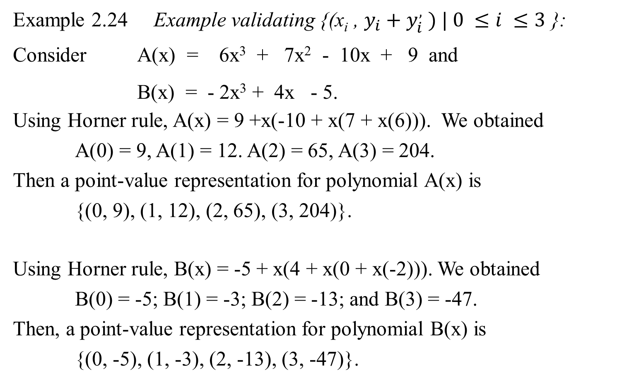
Example 2.24 Example validating {(x_{i} , $y_{i}+y_{i}^{,} ) | 0 ≤i ≤3$ }:
Consider A(x) = 6x³ + 7x² - 10x + 9 and
B(x) = - 2x³ + 4x - 5.
Using Horner rule, A(x) = 9 +x(-10 + x(7 + x(6))). We obtained
A(0) = 9, A(1) = 12. A(2) = 65, A(3) = 204.
Then a point-value representation for polynomial A(x) is
{(0, 9), (1, 12), (2, 65), (3, 204)}.
Using Horner rule, B(x) = -5 + x(4 + x(0 + x(-2))). We obtained
B(0) = -5; B(1) = -3; B(2) = -13; and B(3) = -47.
Then, a point-value representation for polynomial B(x) is
{(0, -5), (1, -3), (2, -13), (3, -47)}.
x | A(x) | B(x) | C(x)
0 | 9 | -5 | 4
1 | 12 | -3 | 9
2 | 65 | -13 | 52
3 | 204 | -47 | 157

Slide 43
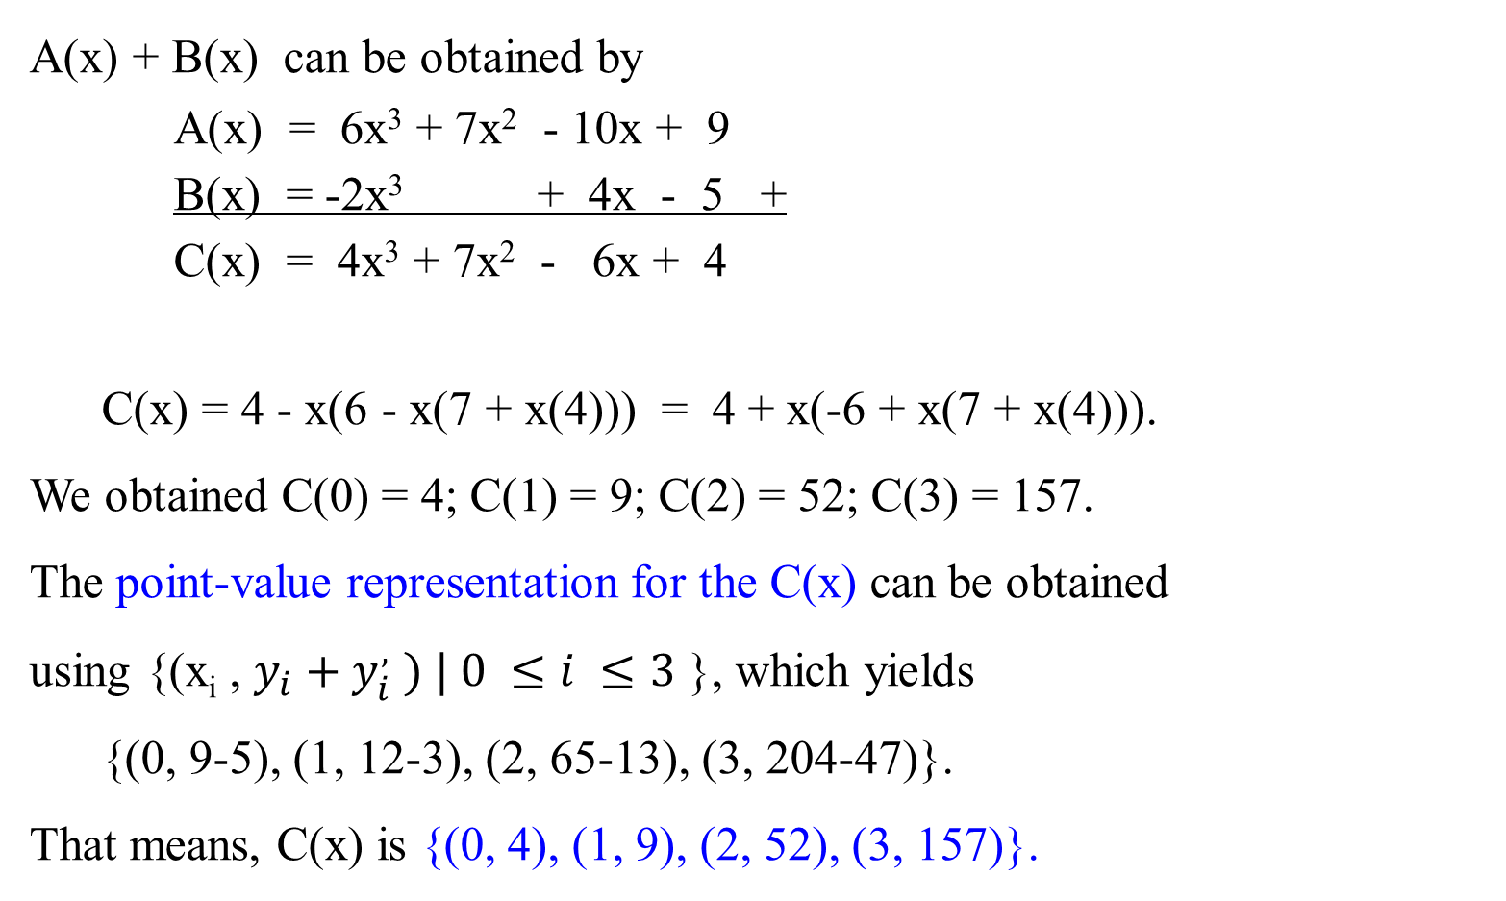
A(x) + B(x) can be obtained by
A(x) = 6x³ + 7x² - 10x + 9
B(x) = -2x³ + 4x - 5 +
C(x) = 4x³ + 7x² - 6x + 4
C(x) = 4 - x(6 - x(7 + x(4))) = 4 + x(-6 + x(7 + x(4))).
We obtained C(0) = 4; C(1) = 9; C(2) = 52; C(3) = 157.
The point-value representation for the C(x) can be obtained
using {(x_{i} , $y_{i}+y_{i}^{,} ) | 0 ≤i ≤3$ }, which yields
{(0, 9-5), (1, 12-3), (2, 65-13), (3, 204-47)}.
That means, C(x) is {(0, 4), (1, 9), (2, 52), (3, 157)}.
For simplicity, use addition to illustrate the obtained the coefficient representation C(x) , then convert to point value representation, which is the same as the result obtained through adding point values pairs.
x | A(x) | B(x) | C(x)
0 | 9 | -5 | 4
1 | 12 | -3 | 9
2 | 65 | -13 | 52
3 | 204 | -47 | 157

Slide 44

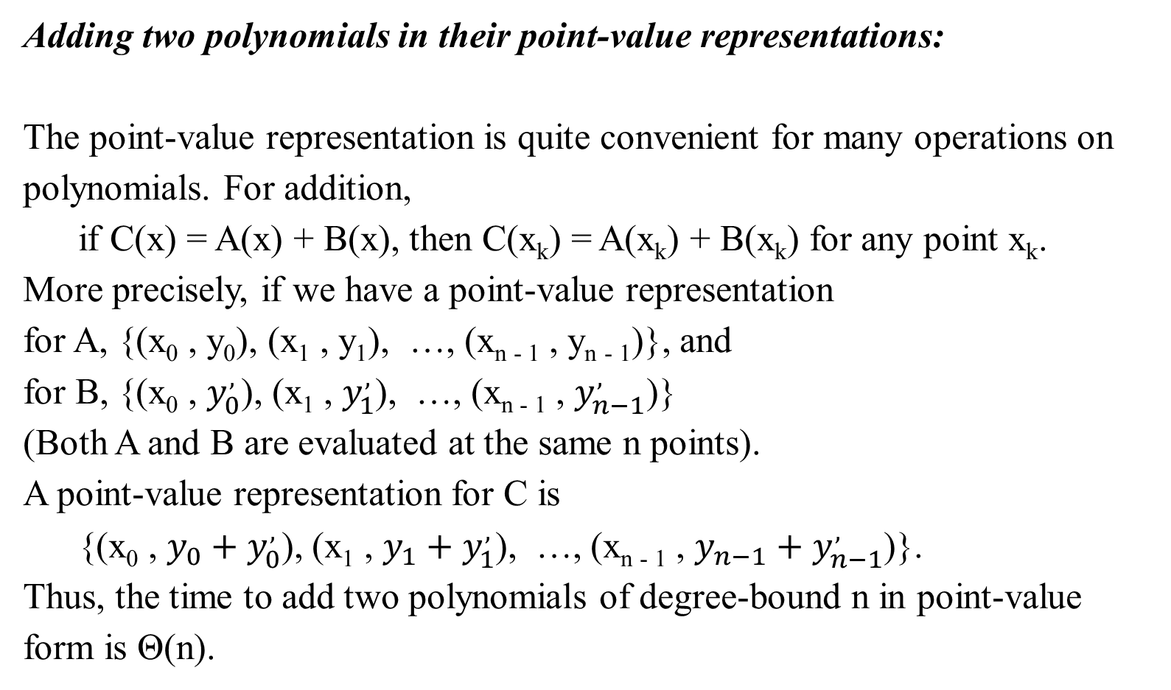
Adding two polynomials in their point-value representations:
The point-value representation is quite convenient for many operations on polynomials. For addition,
if C(x) = A(x) + B(x), then C(x_{k}) = A(x_{k}) + B(x_{k}) for any point x_{k}.
More precisely, if we have a point-value representation
for A, {(x₀ , y₀), (x₁ , y₁), …, (x_{n - 1} , y_{n - 1})}, and
for B, {(x₀ , $y_{0}^{,}$), (x₁ , $y_{1}^{,}$), …, (x_{n - 1} , $y_{n−1}^{,}$)}
(Both A and B are evaluated at the same n points).
A point-value representation for C is
{(x₀ , $y_{0}+y_{0}^{,}$), (x₁ , $y_{1}+y_{1}^{,}$), …, (x_{n - 1} , $y_{n−1}+y_{n−1}^{,}$)}.
Thus, the time to add two polynomials of degree-bound n in point-value form is Θ(n).
S

Slide 45


a₀ , a₁, …, a_{n-1}
b₀ , b₁, …, b_{n-1}
Ordinary
Multiplication
Time Θ(n²)
c₀ , c₁, …, c_{2n-2}
(4, -6, 7, 4, …)
Coefficient
representation
multiple
(9, -10, 7, 6)
(-5, 4, 0, -2).
convolution
Evaluation Interpolation
Time Θ(n²), Time Θ(n²)
using Horner Rule using Lagrange’s formula
$$A\left(x_{0}\right), B\left(x_{0}\right)$$
$$A\left(x_{1}\right), B\left(x_{1}\right)$$
…
$$A\left(x_{2n−2}\right), B\left(x_{2n−2}\right)$$
$$C\left(x_{0}\right)$$
$$C\left(x_{1}\right)$$
…
$$C\left(x_{2n−2}\right)$$
Pointwise multiplication
Point-value
multiplication
Time Θ(n)
(0, 9), (0, -5)
(1, 12), (1, -3)
(2, 65), (2, -13)
(3, 207), (3, -47)
…
(0, 4)
(1, 9)
(2, 52)
(3, 157)
…
To compute A*B

Slide 46

Multiplying two polynomials in their point-value representations:
Let A(x) = a₀ + a₁ $x_{0}$ + a₂ $x_{0}^{2}$ + … + a_{n-1} $x_{0}^{n−1}$ and
B(x) = b₀ + b₁ $x_{0}$ + b₂ $x_{0}^{2}$ + … + b_{n-1} $x_{0}^{n−1}$
An extended point-value representation for A(x) is
{(x₀ , y₀), (x₁ , y₁), …, (x_{2n - 2} , y_{2n - 2})},
and a corresponding extended point-value representation for B(x) is
{(x₀ , $y_{0}^{,}$), (x₁ , $y_{1}^{,}$), …, (x_{2n - 2} , $y_{2n−2}^{,}$)}.
Then a point-value representation for C is
{(x₀ , $y_{0}y_{0}^{,}$), (x₁ , $y_{1}y_{1}^{,}$), …, (x_{2n - 2} , $y_{2n−2}y_{2n−2}^{,}$)}.
--- 2n-1 points; i.e., degree bound 2n-1.
A(x) of degree-bound n=4 can be represented by its coefficient vector (x₀, x₁, x₂, x₃).
A(x) has an extend-represented by (x₀, x₁, x₂, x₃, x₄, x₅, x₆) of degree bound 2n-1=7.

Slide 47

The previous view graphs, we establish the corresponding point value representation and the coefficient representation are equivalent for a given polynomial expressions.
The example 2.21 shows the convolution/evaluation approach to converting the coefficient representation of a polynomial expression to its point value representation
The examples 2.22 and 2.23 show that a point value representation for a polynomial expression can be interpolated to its coefficient representation. 2.23 approach takes Θ(n²) instead of 2.22 approach takes Θ(n³).
The example 2.24 shows that the result of adding two polynomials in coefficient representation is the same result of adding their point value representations.
Now let consider the multiplying two polynomials.

Slide 48
Multiplying two polynomials in their point-value representations

Slide 49
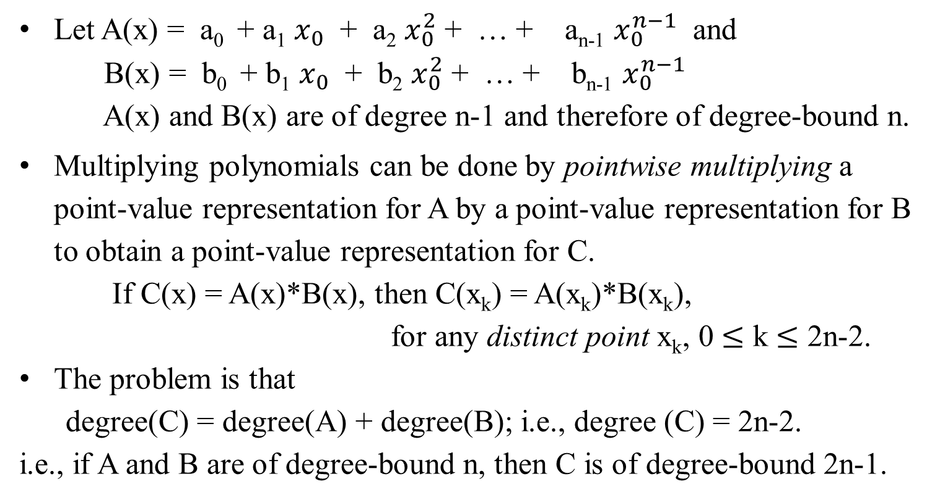
Multiplying two polynomials in their point-value representations:
S
Let A(x) = a₀ + a₁ $x_{0}$ + a₂ $x_{0}^{2}$ + … + a_{n-1} $x_{0}^{n−1}$ and
B(x) = b₀ + b₁ $x_{0}$ + b₂ $x_{0}^{2}$ + … + b_{n-1} $x_{0}^{n−1}$
A(x) and B(x) are of degree n-1 and therefore of degree-bound n.
Multiplying polynomials can be done by pointwise multiplying a point-value representation for A by a point-value representation for B to obtain a point-value representation for C.
If C(x) = A(x)*B(x), then C(x_{k}) = A(x_{k})*B(x_{k}),
for any distinct point x_{k}, 0 $≤$ k $≤$ 2n-2.
The problem is that
degree(C) = degree(A) + degree(B); i.e., degree (C) = 2n-2.
i.e., if A and B are of degree-bound n, then C is of degree-bound 2n-1.

Slide 50
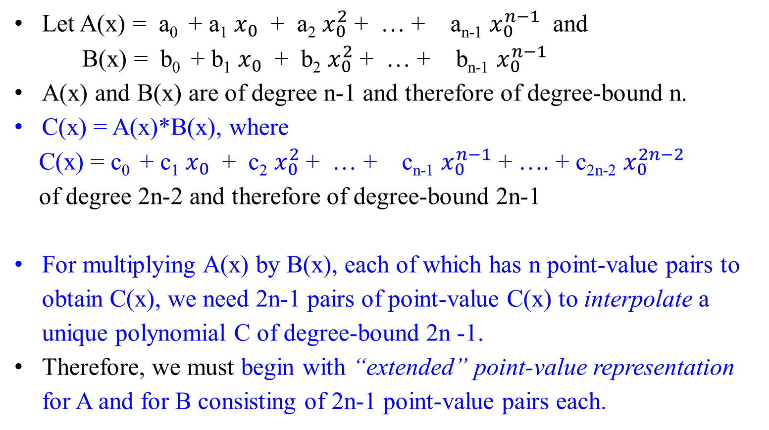
Multiplying two polynomials in their point-value representations:
S
Let A(x) = a₀ + a₁ $x_{0}$ + a₂ $x_{0}^{2}$ + … + a_{n-1} $x_{0}^{n−1}$ and
B(x) = b₀ + b₁ $x_{0}$ + b₂ $x_{0}^{2}$ + … + b_{n-1} $x_{0}^{n−1}$
A(x) and B(x) are of degree n-1 and therefore of degree-bound n.
C(x) = A(x)*B(x), where
C(x) = c₀ + c₁ $x_{0}$ + c₂ $x_{0}^{2}$ + … + c_{n-1} $x_{0}^{n−1}$ + …. + c_{2n-2} $x_{0}^{2n−2}$
of degree 2n-2 and therefore of degree-bound 2n-1
For multiplying A(x) by B(x), each of which has n point-value pairs to obtain C(x), we need 2n-1 pairs of point-value C(x) to interpolate a unique polynomial C of degree-bound 2n -1.
Therefore, we must begin with “extended” point-value representation for A and for B consisting of 2n-1 point-value pairs each.

Slide 51
Multiplying two polynomials in their point-value representations:
Let A(x) = a₀ + a₁ $x_{0}$ + a₂ $x_{0}^{2}$ + … + a_{n-1} $x_{0}^{n−1}$ and
B(x) = b₀ + b₁ $x_{0}$ + b₂ $x_{0}^{2}$ + … + b_{n-1} $x_{0}^{n−1}$
An extended point-value representation for A(x) is
{(x₀ , y₀), (x₁ , y₁), …, (x_{2n - 2} , y_{2n - 2})},
and a corresponding extended point-value representation for B(x) is
{(x₀ , $y_{0}^{,}$), (x₁ , $y_{1}^{,}$), …, (x_{2n - 2} , $y_{2n−2}^{,}$)}.
Then a point-value representation for C is
{(x₀ , $y_{0}y_{0}^{,}$), (x₁ , $y_{1}y_{1}^{,}$), …, (x_{2n - 2} , $y_{2n−2}y_{2n−2}^{,}$)}.
--- 2n-1 points; i.e., degree bound 2n-1.
A(x) of degree-bound n=4 can be represented by its coefficient vector (x₀, x₁, x₂, x₃).
A(x) has an extend-represented by (x₀, x₁, x₂, x₃, x₄, x₅, x₆) of degree bound 2n-1=7.

Slide 52
Multiplying two polynomials in their point-value representations:
Given two input polynomials in extended point-value form,
the time (i.e., number of times) to multiply them to obtain the point-value form of the result is Θ(n),
much less than the time required to multiply polynomials in coefficient form (which takes time Θ(n²)), using the Horner Rules method.
Now, consider how to evaluate a polynomial given in point-value form at a new point.
For this problem, we know of no simpler approach than converting the polynomial to coefficient form first, then evaluating it at the new point.

Slide 53
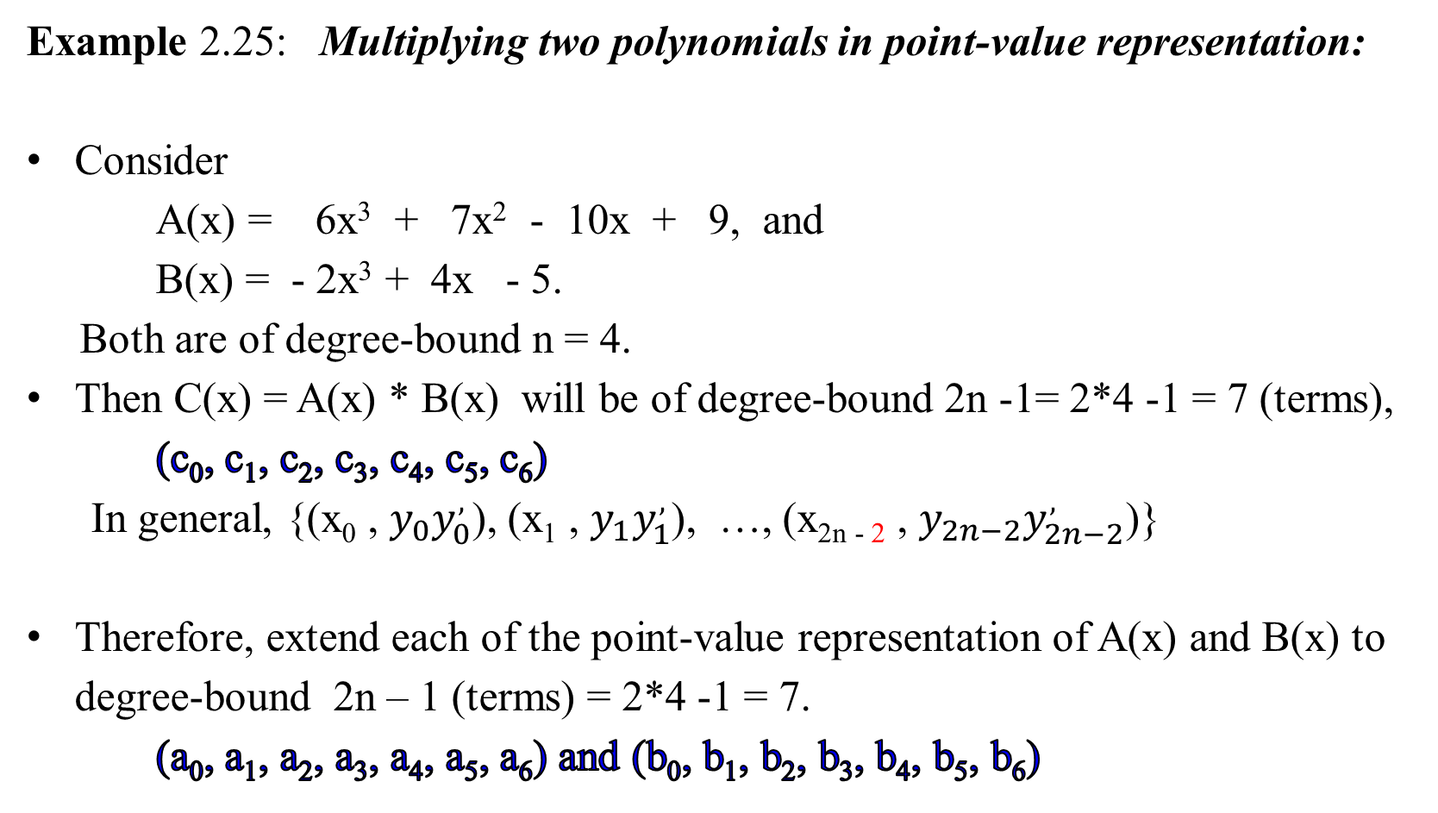
Example 2.25: Multiplying two polynomials in point-value representation:
Consider
A(x) = 6x³ + 7x² - 10x + 9, and
B(x) = - 2x³ + 4x - 5.
Both are of degree-bound n = 4.
Then C(x) = A(x) * B(x) will be of degree-bound 2n -1= 2*4 -1 = 7 (terms),
(c₀, c₁, c₂, c₃, c₄, c₅, c₆)
In general, {(x₀ , $y_{0}y_{0}^{,}$), (x₁ , $y_{1}y_{1}^{,}$), …, (x_{2n - 2} , $y_{2n−2}y_{2n−2}^{,}$)}
Therefore, extend each of the point-value representation of A(x) and B(x) to degree-bound 2n – 1 (terms) = 2*4 -1 = 7.
(a₀, a₁, a₂, a₃, a₄, a₅, a₆) and (b₀, b₁, b₂, b₃, b₄, b₅, b₆)
S

Slide 54
Polynomials in Point-value Representation
Consider A(x) = 6x³ + 7x² - 10x + 9.
We first evaluate 7 point-value pairs for A(x) and B(x):
Using Horner rule,
A(x) = 9 +x(-10 + x(7 + x(6))).
We obtained
A(0) = 9, A(1) = 12, A(2) = 65,
A(3) = 204, A(4) = 465, A(5) = 884,
A(6) = 1497.
The point-value representation for polynomial A(x) is
(0, 9), (1, 12), (2, 65), (3, 204), (4, 465), (5, 884), (6, 1497).
S

Slide 55

Polynomials in Point-value Representation
Consider B(x) = - 2x³ + 4x - 5.
Using Horner rule,
B(x) = -5 + x(4 + x(0 + x(-2))).
We obtained
B(0) = -5, B(1) = -3, B(2) = -13,
B(3) = -47, B(4) = -117, B(5) = -235,
B(6) = -413.
The point-value representation for polynomial B(x) is
(0, -5), (1, -3), (2, -13), (3, -47), (4, -117), (5, -235), (6, -413).
This takes time Θ(n²).

Slide 56
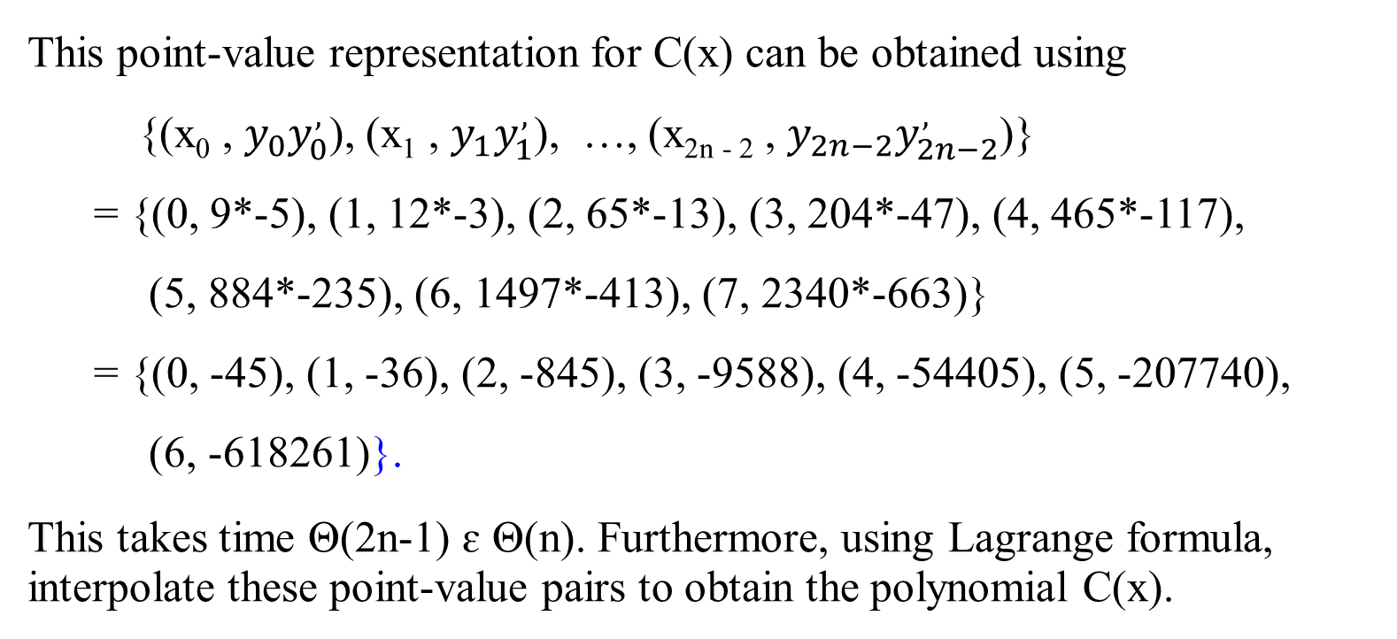
Multiplying two polynomials in point-value representation
S
A(x) is (0, 9), (1, 12), (2, 65), (3, 204), (4, 465), (5, 884), (6, 1497), (7, 2340).
B(x) is (0, -5), (1, -3), (2, -13), (3, -47), (4, -117), (5, -235), (6, -413). (7, -663).
This point-value representation for C(x) can be obtained using
{(x₀ , $y_{0}y_{0}^{,}$), (x₁ , $y_{1}y_{1}^{,}$), …, (x_{2n - 2} , $y_{2n−2}y_{2n−2}^{,}$)}
= {(0, 9*-5), (1, 12*-3), (2, 65*-13), (3, 204*-47), (4, 465*-117),
(5, 884*-235), (6, 1497*-413), (7, 2340*-663)}
= {(0, -45), (1, -36), (2, -845), (3, -9588), (4, -54405), (5, -207740),
(6, -618261)}.
This takes time Θ(2n-1) ɛ Θ(n). Furthermore, using Lagrange formula, interpolate these point-value pairs to obtain the polynomial C(x).

Slide 57
Multiplying two polynomials in point-value representation as in table
 | A(x) * B(x) = C(x)
x | A(x) | B(x) | C(x)
0 | 9 | -5 | -45
1 | 12 | -3 | -36
2 | 65 | -13 | -845
3 | 204 | -47 | -9588
4 | 465 | -117 | -54405
5 | 884 | -235 | -207740
6 | 1497 | -413 | -618261
C(x) = {(0, -45), (1, -36), (2, -845), (3, -9588), (4, -54405), (5, -207740), (6, -618261)}.

Slide 58

In the following two slides, instead of interpolating the point-values of C(x) to its coefficient representation, we first show that: (1) obtain the C(x) in coefficient representation, and then (2) evaluate this representation to form point-values of C(x).
(3) These point-values of C(x) are the same as the previous slide. This shows the correction of the approach.
Instead, we check the obtained point-value pairs by computing A(x) * B(x):
6x³ + 7x² - 10x + 9
- 2x³ + 4x - 5
- 30x³ - 35x² + 50x - 45
+ 24x⁴ + 28x³ - 40x² + 36x
- 12x⁶ - 14x⁵ + 20x⁴ - 18x³ .
- 12x⁶ - 14x⁵ + 44x⁴ - 20x³ - 75x² + 86x - 45
The coefficient for A(x) = 6x³ + 7x² - 10x + 9 is (9, -10, 7, 6, 0, 0, 0).
The coefficient for B(x) = - 2x³ + 4x - 5 is (-5, 4, 0, -2, 0, 0, 0).
The coefficient for C(x) = - 12x⁶ - 14x⁵ + 44x⁴ - 20x³ - 75x² + 86x - 45 is
(-45, 86, -75, -20, 44, -14, -12).

Slide 59
- 12x⁶ - 14x⁵ + 44x⁴ - 20x³ - 75x² + 86x - 45
Using Horner rule
C(x) = -45 + 86x - 75x² - 20x³ + 44x⁴ - 14x⁵ - 12x⁶
= -45 + x(86 + x(-75 + x(-20 + x(44 + x(-14 + x(-12)))))),
we obtained point-value representation for C(x):
C(0) = -45; C(1) = -36; C(2) = -845
C(3) = -9588 C(4) = -54405 C(5) = -207740
C(6) = -618261.
A point-value representation of C(x) is then
{(0, -45), (1, -36), (2, -845), (3, -9588), (4, -54405), (5, -207740),
(6, -618261)}.
Using Lagrange formula, this point-value representation can be interpolated to the corresponding coefficient representation. We will show later.

Slide 60
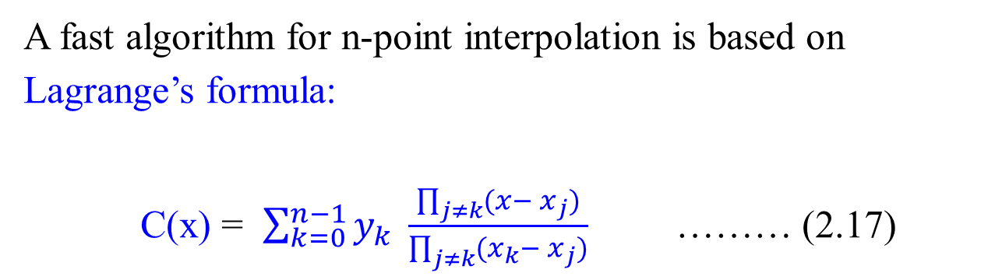
Using Lagrange formula, this point-value representation can be converted to coefficient representation. We will show here.
A fast algorithm for n-point interpolation is based on Lagrange’s formula:
C(x) = $\sum_{k=0}^{n−1}{y_{k}} \frac{\prod_{j≠k}{(x− x_{j})}}{\prod_{j≠k}{(x_{k}}− x_{j})}$ ……… (2.17)

Slide 61
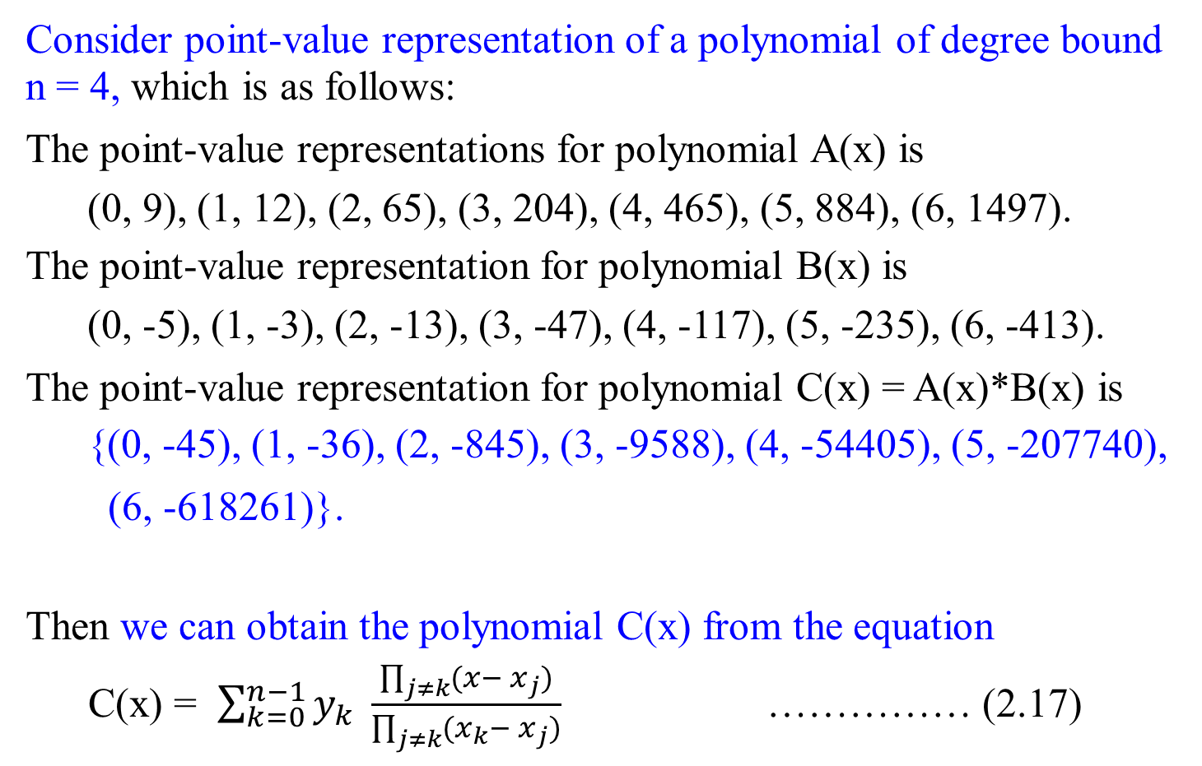
Consider point-value representation of a polynomial of degree bound n = 4, which is as follows:
The point-value representations for polynomial A(x) is
(0, 9), (1, 12), (2, 65), (3, 204), (4, 465), (5, 884), (6, 1497).
The point-value representation for polynomial B(x) is
(0, -5), (1, -3), (2, -13), (3, -47), (4, -117), (5, -235), (6, -413).
The point-value representation for polynomial C(x) = A(x)*B(x) is
{(0, -45), (1, -36), (2, -845), (3, -9588), (4, -54405), (5, -207740),
(6, -618261)}.
Then we can obtain the polynomial C(x) from the equation
C(x) = $\sum_{k=0}^{n−1}{y_{k}} \frac{\prod_{j≠k}{(x− x_{j})}}{\prod_{j≠k}{(x_{k}}− x_{j})}$ …………… (2.17)

Slide 62

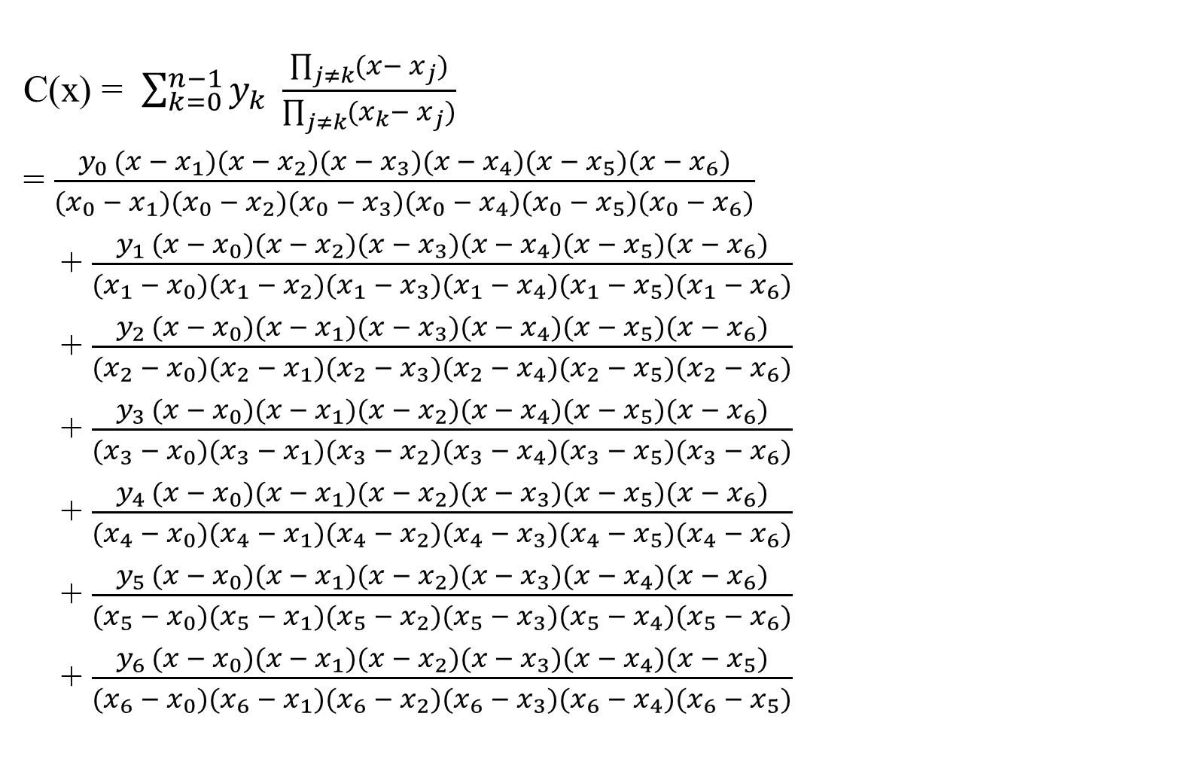
C(x) = $\sum_{k=0}^{n−1}{y_{k}} \frac{\prod_{j≠k}{(x− x_{j})}}{\prod_{j≠k}{(x_{k}}− x_{j})}$
= $\frac{y_{0 }(x − x_{1})(x − x_{2})(x − x_{3})(x − x_{4})(x − x_{5})(x − x_{6})}{(x_{0} − x_{1})(x_{0} − x_{2})(x_{0} − x_{3})(x_{0} − x_{4})(x_{0} − x_{5})(x_{0} − x_{6})}$
+ $\frac{y_{1 }(x − x_{0})(x − x_{2})(x − x_{3})(x − x_{4})(x − x_{5})(x − x_{6})}{(x_{1} − x_{0})(x_{1} − x_{2})(x_{1} − x_{3})(x_{1} − x_{4})(x_{1} − x_{5})(x_{1} − x_{6})}$
+ $\frac{y_{2 }(x − x_{0})(x − x_{1})(x − x_{3})(x − x_{4})(x − x_{5})(x − x_{6})}{(x_{2} − x_{0})(x_{2} − x_{1})(x_{2} − x_{3})(x_{2} − x_{4})(x_{2} − x_{5})(x_{2} − x_{6})}$
+ $\frac{y_{3 }(x − x_{0})(x − x_{1})(x − x_{2})(x − x_{4})(x − x_{5})(x − x_{6})}{(x_{3} − x_{0})(x_{3} − x_{1})(x_{3} − x_{2})(x_{3} − x_{4})(x_{3} − x_{5})(x_{3} − x_{6})}$
+ $\frac{y_{4 }(x − x_{0})(x − x_{1})(x − x_{2})(x − x_{3})(x − x_{5})(x − x_{6})}{(x_{4} − x_{0})(x_{4} − x_{1})(x_{4} − x_{2})(x_{4} − x_{3})(x_{4} − x_{5})(x_{4} − x_{6})}$
+ $\frac{y_{5 }(x − x_{0})(x − x_{1})(x − x_{2})(x − x_{3})(x − x_{4})(x − x_{6})}{(x_{5} − x_{0})(x_{5} − x_{1})(x_{5} − x_{2})(x_{5} − x_{3})(x_{5} − x_{4})(x_{5} − x_{6})}$
+ $\frac{y_{6 }(x − x_{0})(x − x_{1})(x − x_{2})(x − x_{3})(x − x_{4})(x − x_{5})}{(x_{6} − x_{0})(x_{6} − x_{1})(x_{6} − x_{2})(x_{6} − x_{3})(x_{6} − x_{4})(x_{6} − x_{5})}$
Each term requires 2*(2n-1) multiplications. There are (2n-1) terms. Therefore the total number of multiplications needed is 2*(2n-1) * (2n-1). This takes time Θ(n²).

Slide 63
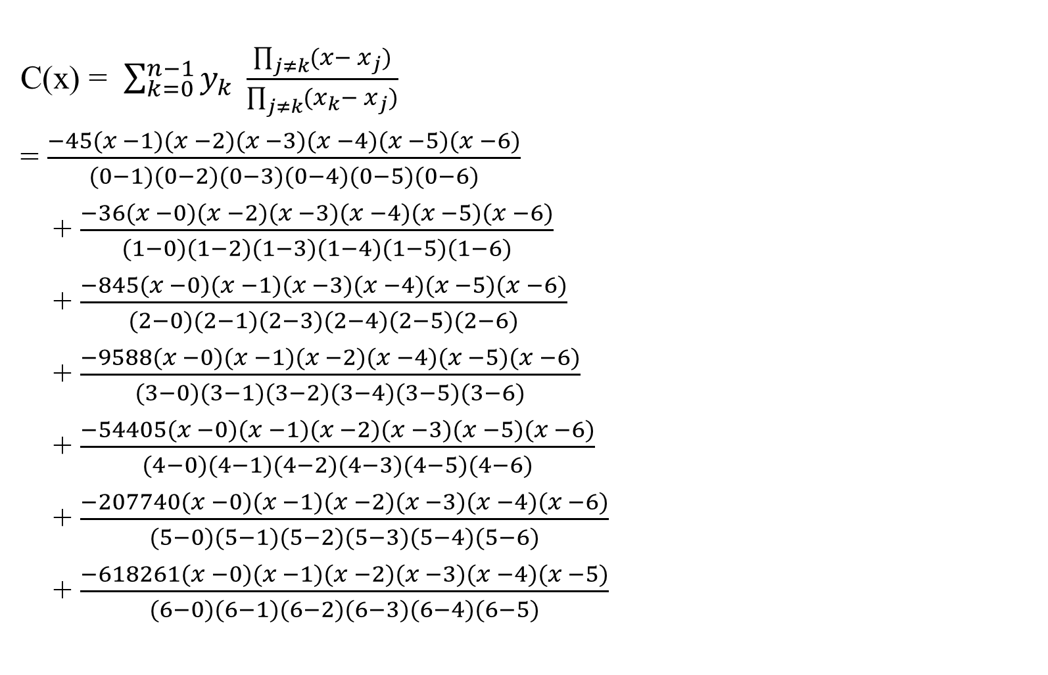
C(x) = $\sum_{k=0}^{n−1}{y_{k}} \frac{\prod_{j≠k}{(x− x_{j})}}{\prod_{j≠k}{(x_{k}}− x_{j})}$
= $\frac{−45(x −1)(x −2)(x −3)(x −4)(x −5)(x −6)}{(0−1)(0−2)(0−3)(0−4)(0−5)(0−6)}$
+ $\frac{−36(x −0)(x −2)(x −3)(x −4)(x −5)(x −6)}{(1−0)(1−2)(1−3)(1−4)(1−5)(1−6)}$
+ $\frac{−845(x −0)(x −1)(x −3)(x −4)(x −5)(x −6)}{(2−0)(2−1)(2−3)(2−4)(2−5)(2−6)}$
+ $\frac{−9588(x −0)(x −1)(x −2)(x −4)(x −5)(x −6)}{(3−0)(3−1)(3−2)(3−4)(3−5)(3−6)}$
+ $\frac{−54405(x −0)(x −1)(x −2)(x −3)(x −5)(x −6)}{(4−0)(4−1)(4−2)(4−3)(4−5)(4−6)}$
+ $\frac{−207740(x −0)(x −1)(x −2)(x −3)(x −4)(x −6)}{(5−0)(5−1)(5−2)(5−3)(5−4)(5−6)}$
+ $\frac{−618261(x −0)(x −1)(x −2)(x −3)(x −4)(x −5)}{(6−0)(6−1)(6−2)(6−3)(6−4)(6−5)}$
{(0, -45), (1, -36), (2, -845), (3, -9588), (4, -54405), (5, -207740), (6, -618261)}.

Slide 64
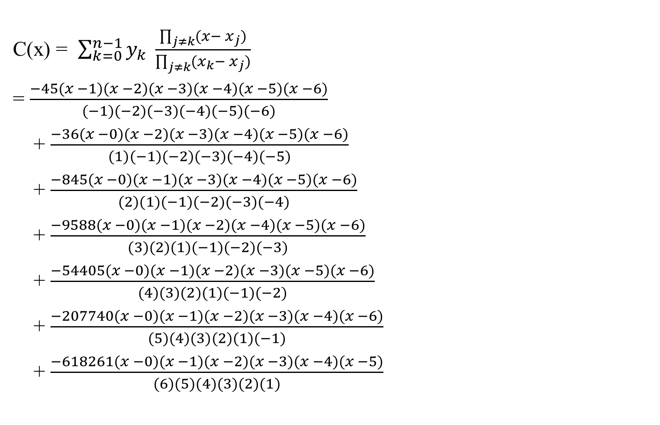
C(x) = $\sum_{k=0}^{n−1}{y_{k}} \frac{\prod_{j≠k}{(x− x_{j})}}{\prod_{j≠k}{(x_{k}}− x_{j})}$
= $\frac{−45(x −1)(x −2)(x −3)(x −4)(x −5)(x −6)}{(−1)(−2)(−3)(−4)(−5)(−6)}$
+ $\frac{−36(x −0)(x −2)(x −3)(x −4)(x −5)(x −6)}{(1)(−1)(−2)(−3)(−4)(−5)}$
+ $\frac{−845(x −0)(x −1)(x −3)(x −4)(x −5)(x −6)}{(2)(1)(−1)(−2)(−3)(−4)}$
+ $\frac{−9588(x −0)(x −1)(x −2)(x −4)(x −5)(x −6)}{(3)(2)(1)(−1)(−2)(−3)}$
+ $\frac{−54405(x −0)(x −1)(x −2)(x −3)(x −5)(x −6)}{(4)(3)(2)(1)(−1)(−2)}$
+ $\frac{−207740(x −0)(x −1)(x −2)(x −3)(x −4)(x −6)}{(5)(4)(3)(2)(1)(−1)}$
+ $\frac{−618261(x −0)(x −1)(x −2)(x −3)(x −4)(x −5)}{(6)(5)(4)(3)(2)(1)}$
{(0, -45), (1, -36), (2, -845), (3, -9588), (4, -54405), (5, -207740), (6, -618261)}.

Slide 65

C(x) = $\sum_{k=0}^{n−1}{y_{k}} \frac{\prod_{j≠k}{(x− x_{j})}}{\prod_{j≠k}{(x_{k}}− x_{j})}$
= $\frac{−45( x^{6} −21x^{5}+176x^{4} −735x^{3}+1624x^{2}−1764x+720)}{720}$
+ $\frac{−36( x^{6} −20x^{5}+155x^{4} −580x^{3}+1044x^{2}−720x)}{−120}$
+ $\frac{−845( x^{6} −19x^{5}+137x^{4} −461x^{3}+702x^{2}−360x)}{48}$
+ $\frac{−9588( x^{6} −18x^{5}+121x^{4} −372x^{3}+508x^{2}−240x)}{−36}$
+ $\frac{−54405( x^{6} −17x^{5}+110x^{4} −325x^{3}+396x^{2}−180x)}{48}$
+ $\frac{−207740( x^{6} −16x^{5}+95x^{4} −260x^{3}+324x^{2}−144x)}{(5)(4)(3)(2)(1)(−1)}$
+ $\frac{−618261( x^{6} −15x^{5}+80x^{4} −225x^{3}+274x^{2}−120x)}{720}$
{(0, -45), (1, -36), (2, -845), (3, -9588), (4, -54405), (5, -207740), (6, -618261)}.

Slide 66
{(0, -45), (1, -36), (2, -845), (3, -9588), (4, -54405), (5, -207740), (6, -618261)}.
Simplify the above equation to obtain
C(x) = -12x⁶ - 14x⁵ + 44x⁴ - 20x³ - 75x² + 86x - 45,
which is the product of
A(x) = 6x³ + 7x² - 10x + 9 and
B(x) = - 2x³ + 4x - 5.
This takes time Θ(n²).

Slide 68
Comment: for x³, If n-1=3, then n=4 terms for x⁶, if 2n-1=6, then 2n=7 terms
a₀ , a₁, …, a_{n-1}
b₀ , b₁, …, b_{n-1}
Ordinary
Multiplication
Time Θ(n²)
c₀ , c₁, …, c_{2n-2}
Coefficient
representation
Evaluation Interpolation
Time Θ(n²), Time Θ(n²)
using Horner Rule using Lagrange’s formula
S
$$A\left(x_{0}\right), B\left(x_{0}\right)$$
$$A\left(x_{1}\right), B\left(x_{1}\right)$$
…
$$A\left(x_{2n−2}\right), B\left(x_{2n−2}\right)$$
$$C\left(x_{0}\right)$$
$$C\left(x_{1}\right)$$
…
$$C\left(x_{2n−2}\right)$$
Pointwise multiplication
Point-value
multiplication
Time Θ(n)

Slide 69

So far, both the evaluation and interpolation take time Θ(n²).
Given two polynomials A(x) and B(x),
use Horner Rule to evaluate A(x) at n points, and B(x) at n points, (which takes time 2* Θ(n²)), and then
use the obtained point-value forms to compute pointwise multiplication (which takes time Θ(n) ).
Then interpolate C(x) from n points of point-value representation to coefficient form, using Lagrange’s formula (this interpolation also take time Θ(n²)).
Therefore, the process of evaluation, then pointwise multiplication and then of interpolation takes total time
Θ(n²) + Θ(n) + Θ(n²) $∈$Θ(n²).
This considers worse than ordinary multiplication.
S

Slide 70
S
Can we improve our method?
Can we use the linear-time multiplication method for polynomials in point-value form to expedite polynomial multiplication in coefficient form?
The answer hinges on whether we can convert a polynomial quickly from coefficient form to point-value form (evaluate) and vice versa (interpolate).

Slide 71

Fast multiplication of polynomials in coefficient form
Figure 2.10: A graphical outline of an efficient polynomial-multiplication process. Representation on the top are in coefficient form, while those on the bottom are in point-value form. The arrows from left to right correspond to the multiplication operation. The $ѡ_{2n}$terms are complex (2n)^{th} roots of unity.
S

Slide 72



Comment: for x³, If n-1=3, then n=4 terms for x⁶, if 2n-1=6, then 2n=7 terms
a₀ , a₁, …, a_{n-1}
b₀ , b₁, …, b_{n-1}
Ordinary
Multiplication
Time Θ(n²)
c₀ , c₁, …, c_{2n-2}
Coefficient
representation
S
Evaluation Interpolation
Time Θ(n log n) Time Θ(n log n)
$$A\left(ѡ_{2n}^{0}\right), B\left(ѡ_{2n}^{0}\right)$$
$$A\left(ѡ_{2n}^{1}\right), B\left(ѡ_{2n}^{1}\right)$$
…
$$A\left(ѡ_{2n}^{2n−2}\right), B\left(ѡ_{2n}^{2n−2}\right)$$
$$C\left(ѡ_{2n}^{0}\right)$$
$$C\left(ѡ_{2n}^{1}\right)$$
…
$$C\left(ѡ_{2n}^{2n−2}\right)$$
Pointwise multiplication
Point-value
multiplication
Time Θ(n)
The $ѡ_{2n}$terms are complex (2n)^{th} roots of unity.

